Slide 1
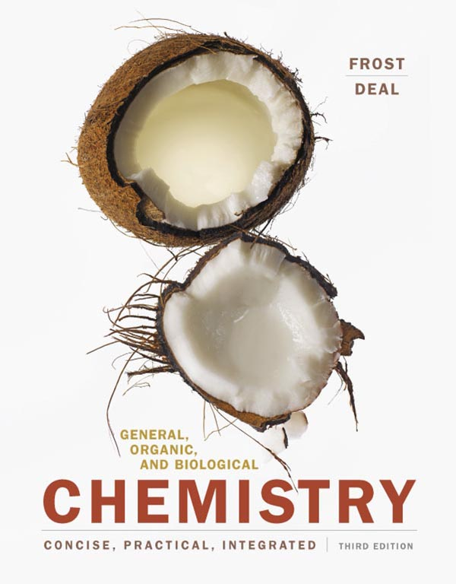
Chapter 5 Chemical Reactions

Slide 2
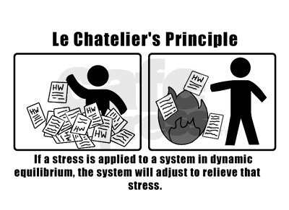
Announcements
Don’t forget to do your Mastering Chemistry Homework!

Slide 3
Outline
5.1 Thermodynamics
5.2 Chemical Reactions: Kinetics
5.3 Overview of Chemical Reactions
5.4 Oxidation and Reduction
5.5 Organic Reactions: Condensation and Hydrolysis
5.6 Organic Addition Reactions to Alkenes

Slide 4
5.1 Thermodynamics
A reaction that gives off heat is an exothermic reaction (exo, “out”; thermic, “heat”; heat flows out).
NaC₂H₃O₂(aq) → NaC₂H₃O₂(s) + Heat
Reactions requiring heat energy are endothermic reactions (endo, “in”; thermic, “heat”; heat flows in).
Heat + NH₄NO₃(s) → NH₄NO₃(aq)
The difference in heat between the reactants and the products is the heat of reaction. It determines whether a reaction is exothermic or endothermic.

Slide 5
5.1 Thermodynamics
Randomness
For any chemical reaction, the heat of the reaction and the randomness of both reactants and products must be considered.
Free Energy and ΔG
The energy exchanged during a chemical reaction is free energy (G), or Gibbs free energy.
This is the amount of energy present in molecules available to do work.
The free energy change, ΔG, is the energy difference between the free energy present in the product and that in the reactant molecules.

Slide 6
5.1 Thermodynamics
Because ΔG includes both heat and randomness, the terms exergonic (gives off energy) and endergonic (requires energy) are used.
For an exergonic reaction, the free energy of the reactants is greater than the free energy of the products and ΔG is negative.
Reactions with a negative ΔG value do not require energy input and occur spontaneously.
Spontaneous processes will continue to occur once started and do not require energy from the surroundings.

Slide 7
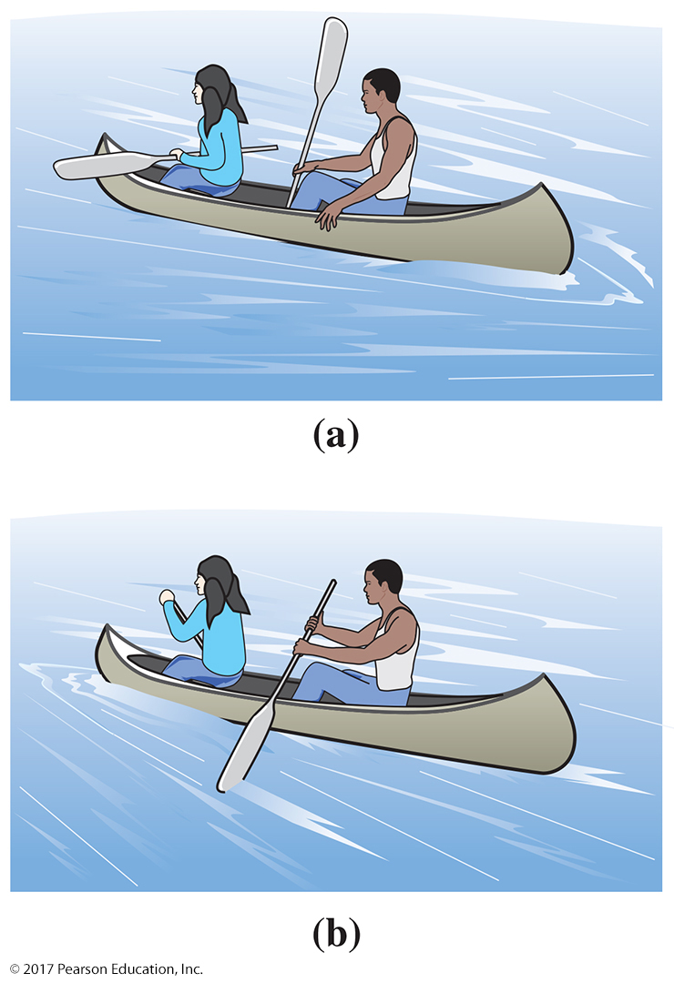
5.1 Thermodynamics
Reactions with a positive ΔG value require energy input from their surroundings and are nonspontaneous.
Nonspontaneous processes do not occur naturally and require energy input.
A canoe can go upstream only if the paddler inputs energy.

Slide 8
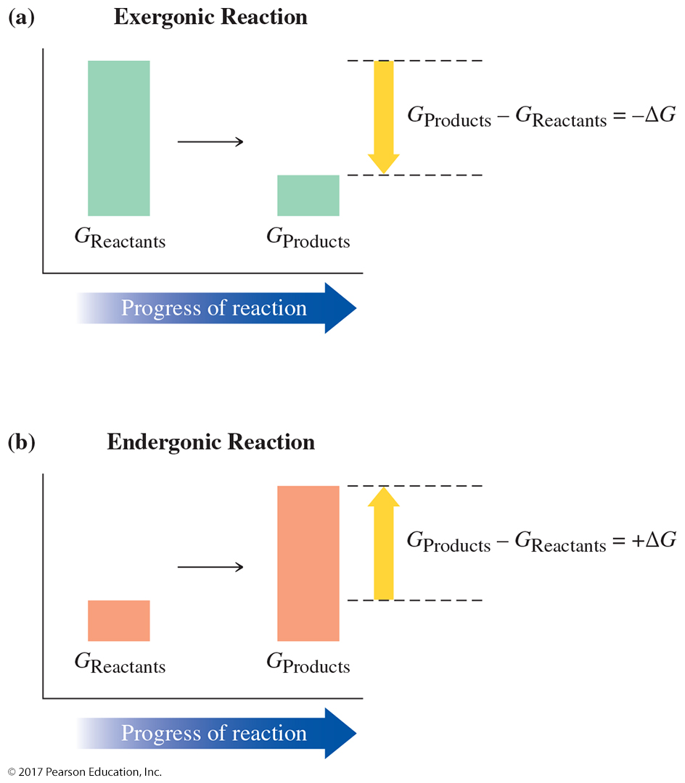
5.1 Thermodynamics

Slide 9
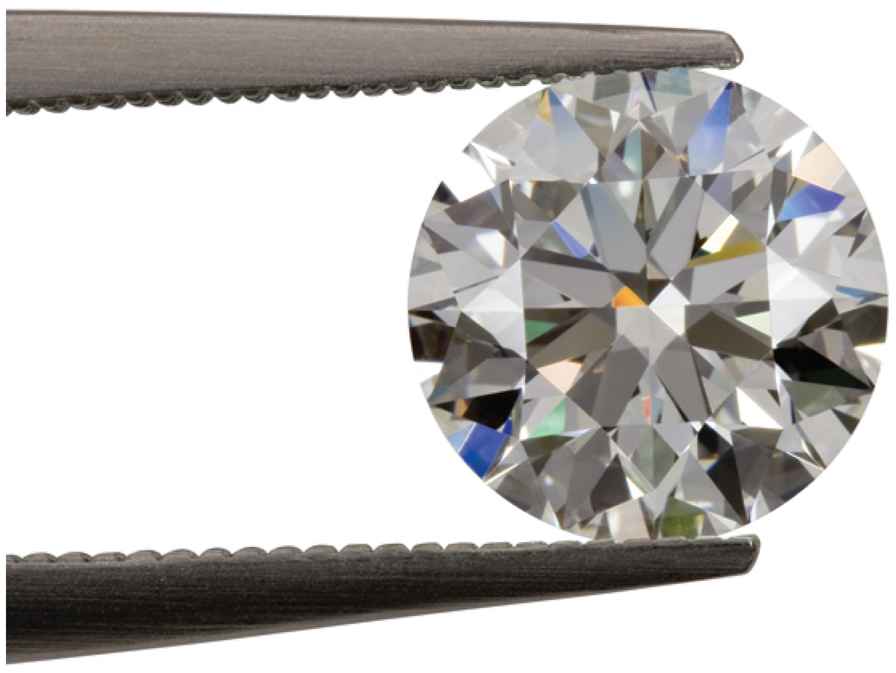
5.1 Thermodynamics
In a living system, the free energy given off in one chemical reaction is coupled as input to another chemical reaction.
The main molecule that transfers energy in living systems is adenosine triphosphate, ATP.
The spontaneity of a reaction does not tell us how fast a reaction occurs.

Slide 10
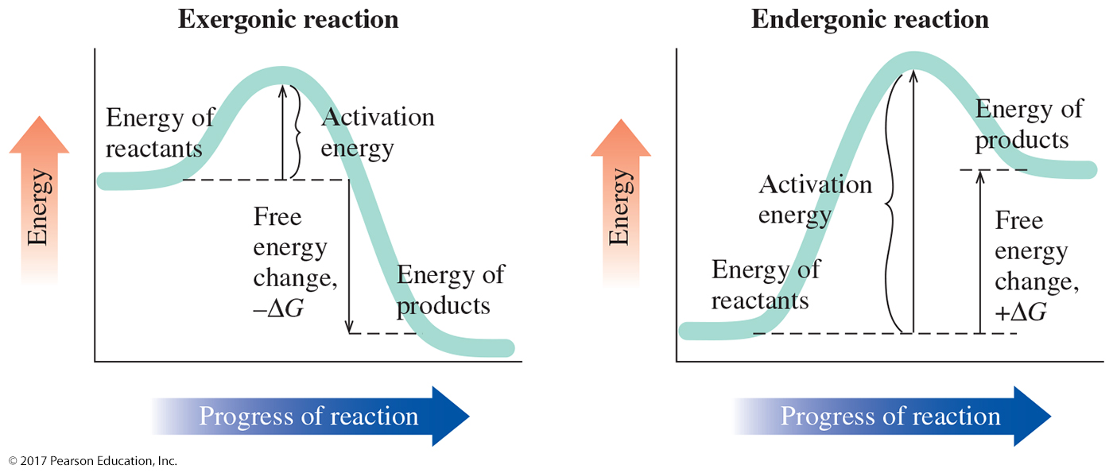
5.1 Thermodynamics
Some reactions need a little “push” to get started.
The energy necessary to align the reactant molecules and cause them to collide with enough force to react is the activation energy.

Slide 11
Learning Check
In your own words, explain the difference between endothermic and exothermic reactions. What is the difference in their energy diagrams?

Slide 12
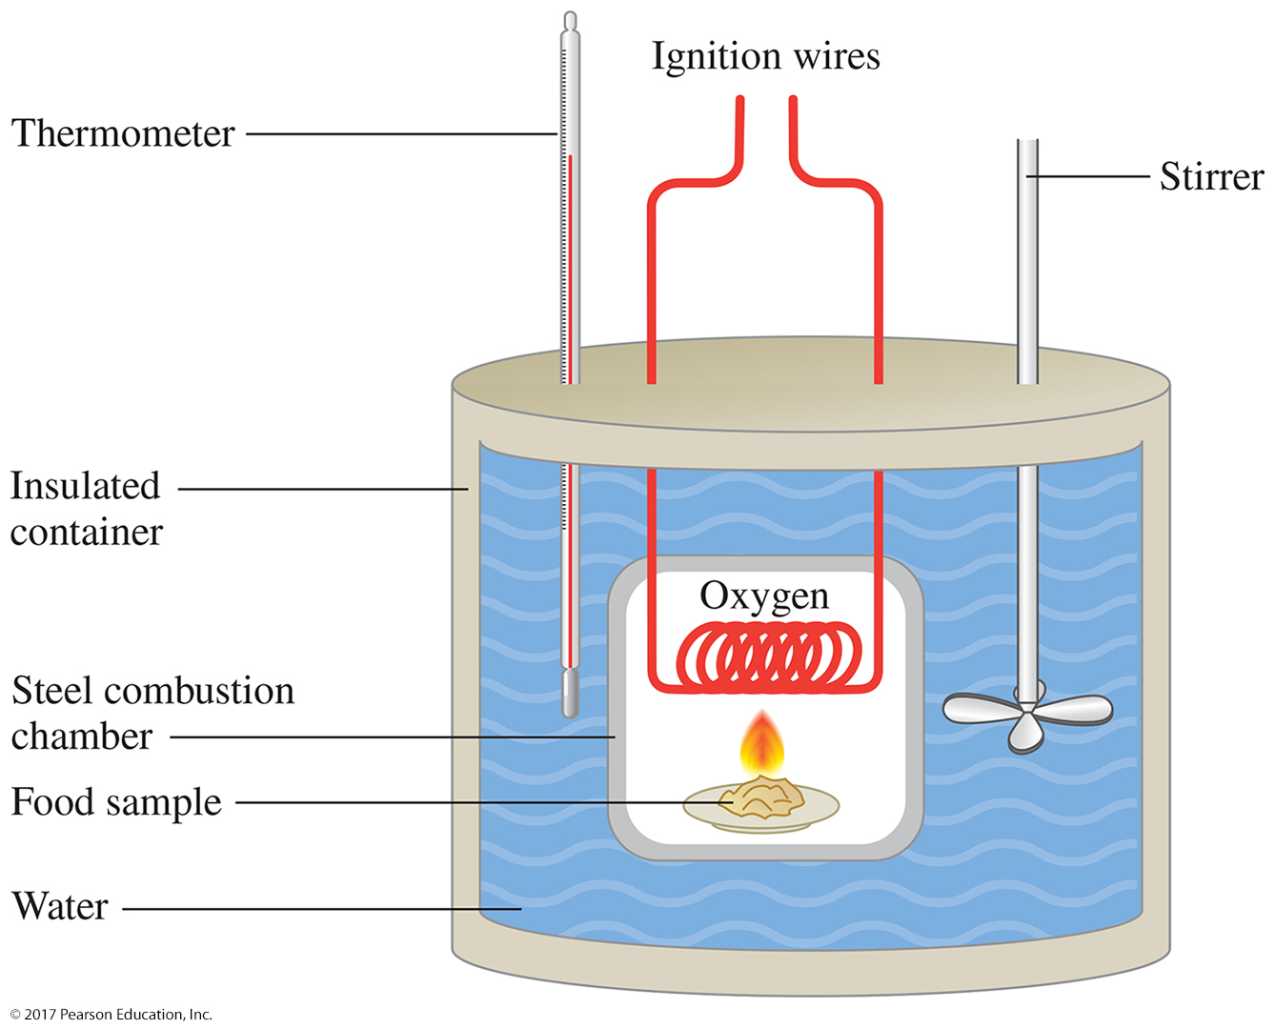
5.1 Thermodynamics
Calorimetry: An Application of Thermodynamics
A calorimeter measures the amount of energy in food by burning the food in the presence of oxygen. This is a combustion reaction.
The food is placed inside a closed container surrounded by water and burned.
The change in the temperature of the water is directly related to the amount of energy released.
The energy is commonly reported in units of nutritional Calories or kilojoules.
Remember that a nutritional Calorie (Cal) is an energy unit equal to 1000 calories (cal).

Slide 13
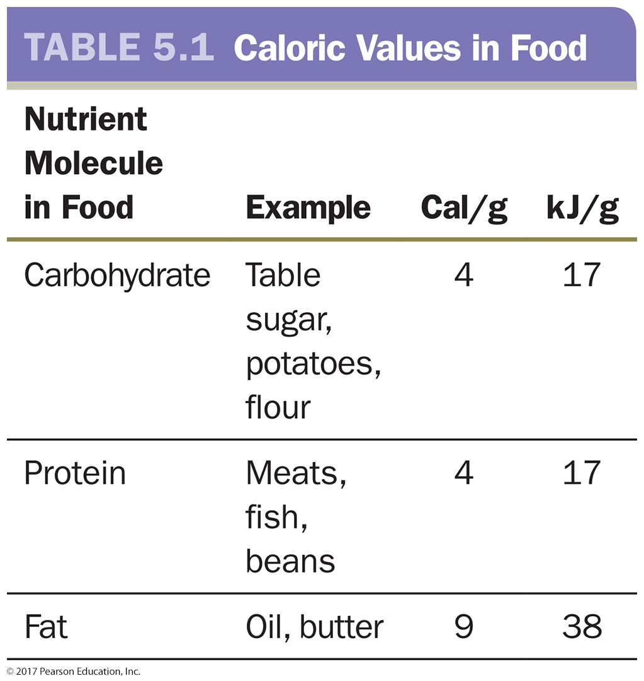
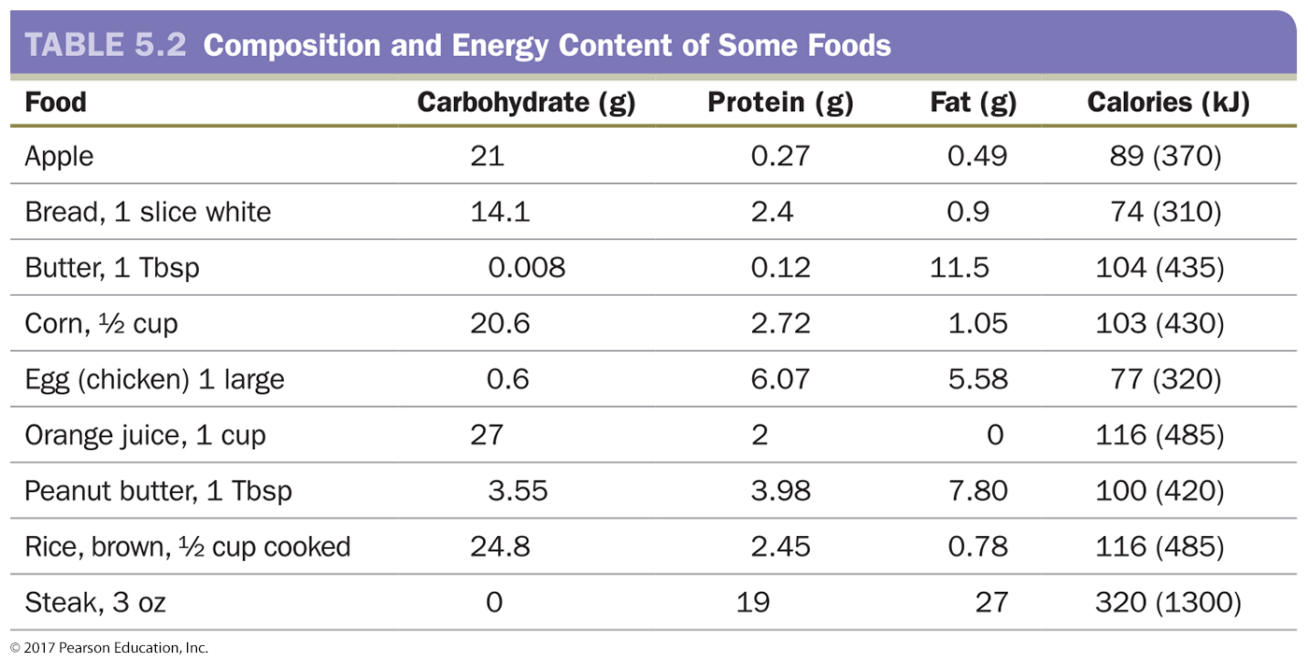
5.1 Thermodynamics
Energy Content in Food
We talk about burning Calories.
Outside the body or inside the body, when oxygen reacts with molecules producing carbon dioxide, water, and energy, the process that takes place is combustion.
The food we eat contains different kinds of energy.

Slide 14
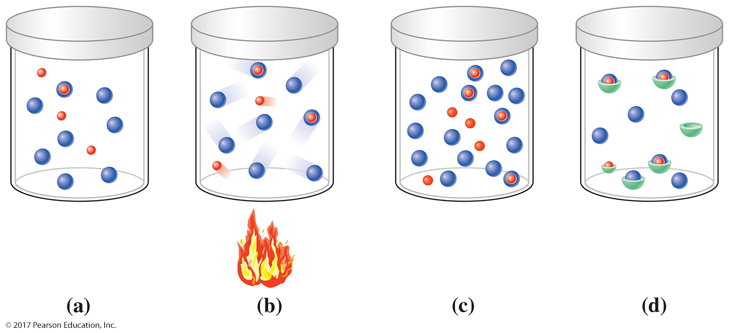
5.2 Chemical Reactions: Kinetics
We can measure the rate of reaction by determining the amount of product formed (or reactant used up) in a certain period of time.
For a chemical reaction to occur, the molecules of the reactant(s) must collide with each other with enough energy and the proper orientation.
Any factor that affects the rate of collision or the energy available to the reaction affects the rate of the reaction.

Slide 15
5.2 Chemical Reactions: Kinetics
Temperature
Increasing temperature increases the kinetic energy (motion) of the reacting molecules.
As a result, they collide with each other more often, causing more reactions to occur.
Amount of Reactant
The rate of chemical reactions increases with the amount of reactants.
More reactant availability allows molecules to collide with each other more often, causing more reactions to occur.
As reactants are consumed and form products, chemical reactions slow down due to a decrease in the amount of reactants.

Slide 16
5.2 Chemical Reactions: Kinetics
Presence of a Catalyst
A catalyst speeds up a reaction by lowering the activation energy.
A catalyst participates in a chemical reaction but remains unchanged and can be used again.
A catalyst is neither a product nor a reactant.
Acids, bases, and metal ions often act as catalysts.
Many catalysts immobilize reactants near each other, increasing the likelihood of collision and therefore the rate of reaction.

Slide 17
5.2 Chemical Reactions: Kinetics
Presence of a Catalyst
When hydrogen peroxide is put on a cut, oxygen gas is produced by the decomposition of hydrogen peroxide by an enzyme, catalase, found in the blood.
catalase
2H₂O₂(l) → 2H₂O(l) + O₂(g)
Catalysts are written above or below the arrow in the reaction equation.
In the absence of the catalyst, the hydrogen peroxide reaction occurs very slowly.

Slide 18
5.2 Chemical Reactions: Kinetics
Enzymes Are Biological Catalysts
The body maintains a constant temperature.
The amount of reactant present in cells is constant.
Most biochemical reactions use enzymes to increase reaction rates.
Most enzymes are proteins.
Enzymes can enhance the rate of a chemical reaction by a factor of more than ten million (1 × 10⁷).
Enzymes speed up reactions by immobilizing the reactants at an active site, which orients them correctly for the reaction to occur.
Enzymes are highly specific: When they are defective, the result is often a diseased state in the organism.

Slide 19
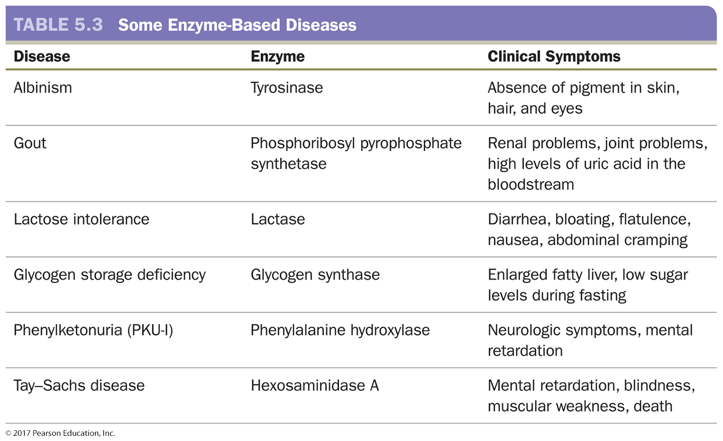
5.2 Chemical Reactions: Kinetics

Slide 20
Learning Check
Answer the following questions.
How would decreasing the temperature effect the rate of reaction?
How would adding more reactants effect the rate of reaction?

Slide 21
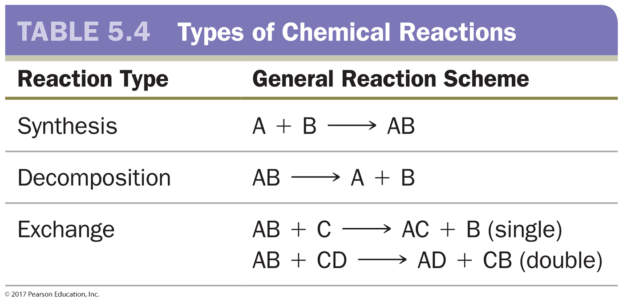
5.3 Overview of Chemical Reactions
Synthesis reactions occur when smaller molecules or atoms combine to create larger molecules. These reactions have only one product.
Decomposition reactions break apart larger molecules into smaller molecules. These reactions have only one reactant.
Exchange reactions, sometimes called displacement or replacement reactions, involve both synthesis and decomposition.

Slide 22
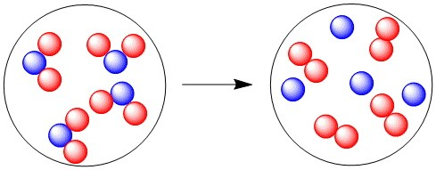
Learning Check
What type of reaction is illustrated in this diagram?

Slide 23
Learning Check
Identify the type of reaction:
4Fe(s) + 3O₂(g) ⟶ 2Fe₂O₃(s)
Ca(s) + H₂SO₄(aq) → CaSO₄(aq) + H₂(g)

Slide 24
5.3 Overview of Chemical Reactions
Reversible reactions can form products in either direction.
If a chemical bond can be formed, with enough input of energy it can also be broken.
Reversible chemical reactions are indicated with a pair of arrows between the reactants and products pointing in opposite directions.
A + B
AB

Slide 25
5.3 Overview of Chemical Reactions
A + B
AB
The forward reaction occurs when A and B form AB.
When a sufficient amount of AB builds up, the reverse reaction occurs and A and B re-form.
At the point when both the forward and the reverse reaction are occurring at the same rate, the reaction is said to be in a state of chemical equilibrium.
This does not mean that there are equal amounts of reactants and products; it means that the reaction reaches a point at which the rate of forward and reverse reactions is the same.

Slide 26
5.3 Overview of Chemical Reactions
Reactions that are highly exothermic are, for practical purposes, considered irreversible reactions.
When we break down food, these chemical reactions are never reversed to re-form the actual food.
Instead, the energy produced is used to form other molecules and maintain bodily functions.

Slide 27
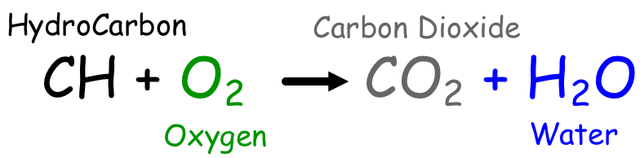
5.3 Overview of Chemical Reactions
Combustion
Combustion involves a carbon-containing molecule reacting with oxygen to produce carbon dioxide and water.
Combustion reactions tend to be highly exothermic and are considered irreversible.
Combustion reactions use oxygen and produce energy, whether it dissipates as heat or performs work.
These reactions are an important part of understanding fuels.

Slide 28
5.3 Overview of Chemical Reactions
Alkanes
Alkanes are excellent fuel sources because they give off a lot of energy when burned.
Internal combustion engines emit partially reacted hydrocarbons in their exhaust.
Other hydrocarbons are not completely oxidized, and carbon soot results.
The term clean-burning refers to the efficiency of the combustion. The cleaner a fuel burns, the more complete the combustion.

Slide 29
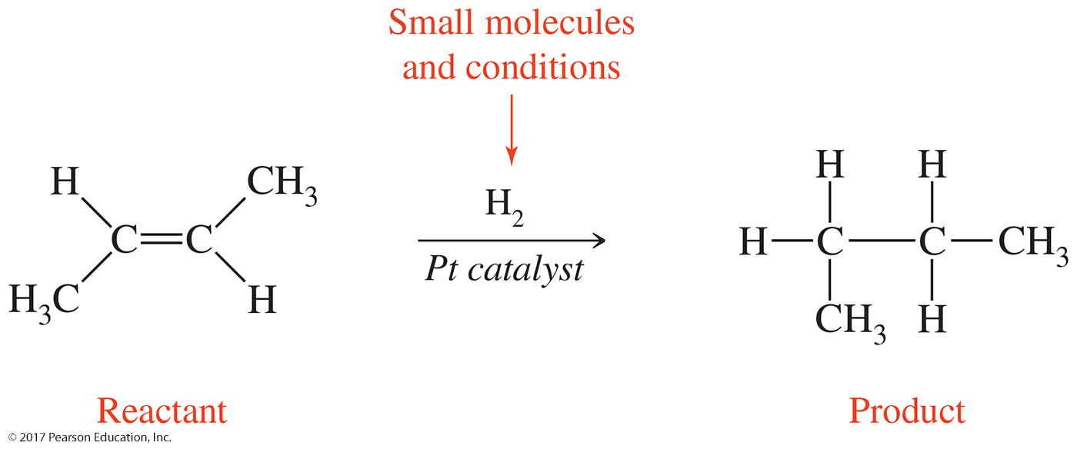
5.3 Overview of Chemical Reactions
Distinguishing Chemical Reactions
For many organic reactions, the interesting part is the reaction mechanism.
In an organic chemical equation, the structure of organic molecules is written out.
Small molecules that participate in the reaction are shown above the reaction arrow, and reaction conditions are shown below the arrow.

Slide 30
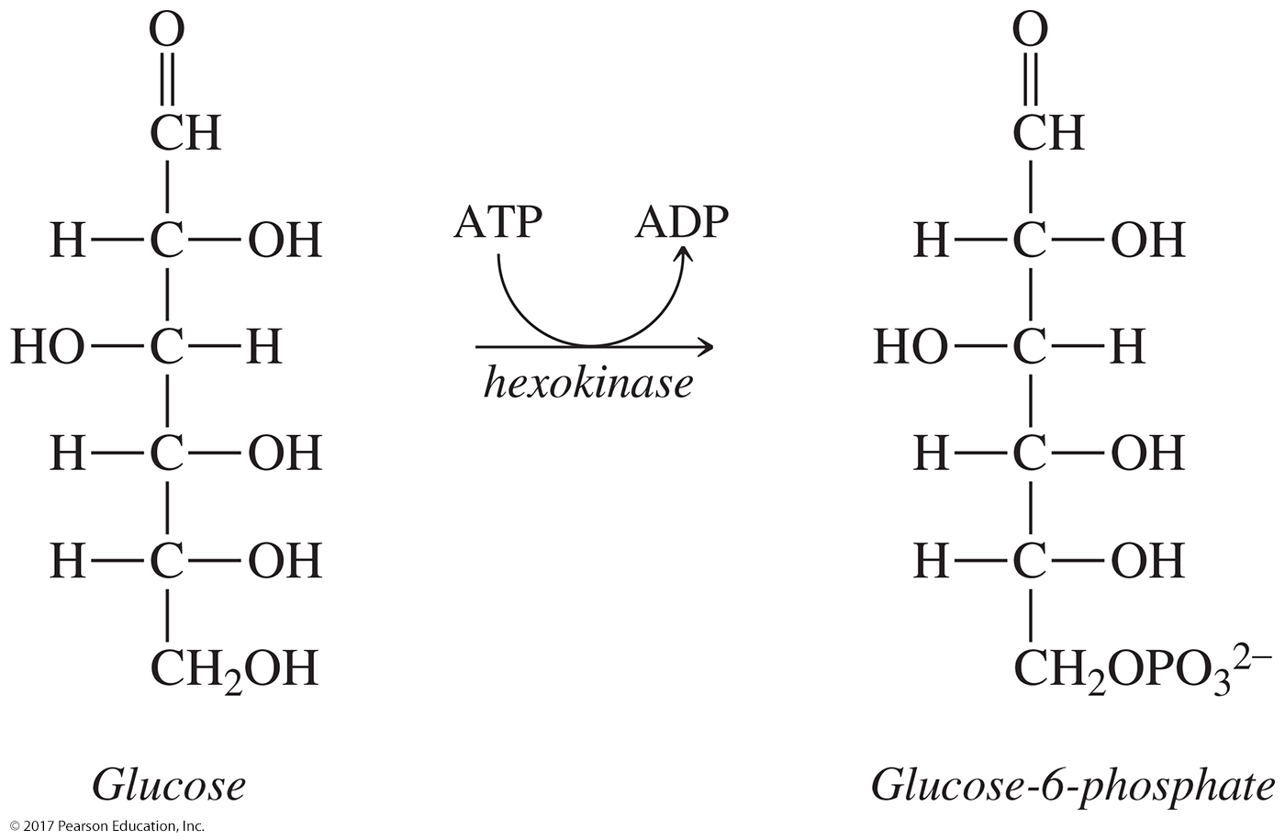
5.3 Overview of Chemical Reactions
Distinguishing Chemical Reactions
Biochemical reactions are written like organic reactions: The reactant, product, and reaction conditions are shown.
Sometimes biochemical reactions are coupled: Energy is transferred from one reaction to fuel the other.
The two reactions are often written together, with the energy transfer reaction written at the arrow.

Slide 31
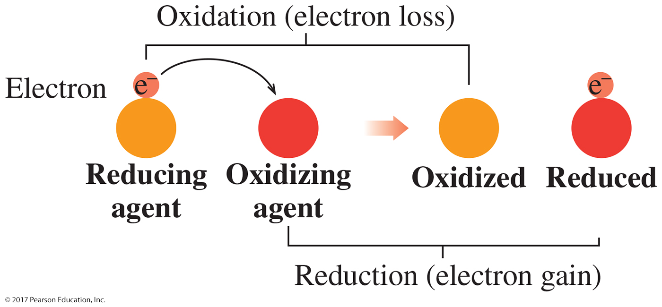
5.4 Oxidation and Reduction
Oxidation–reduction or redox reactions can be identified in two ways:
They involve metal ions and the movement of electrons (inorganic) or
they involve the addition or removal of oxygen and hydrogen (organic).

Slide 32
5.4 Oxidation and Reduction
Inorganic Oxidation and Reduction
4Fe(s) + 3O₂(g) ⟶ 2Fe₂O₃(s)
Atoms that lose electrons during a chemical reaction are said to undergo oxidation.
Atoms that gain electrons during a chemical reaction are said to undergo reduction.

Slide 33
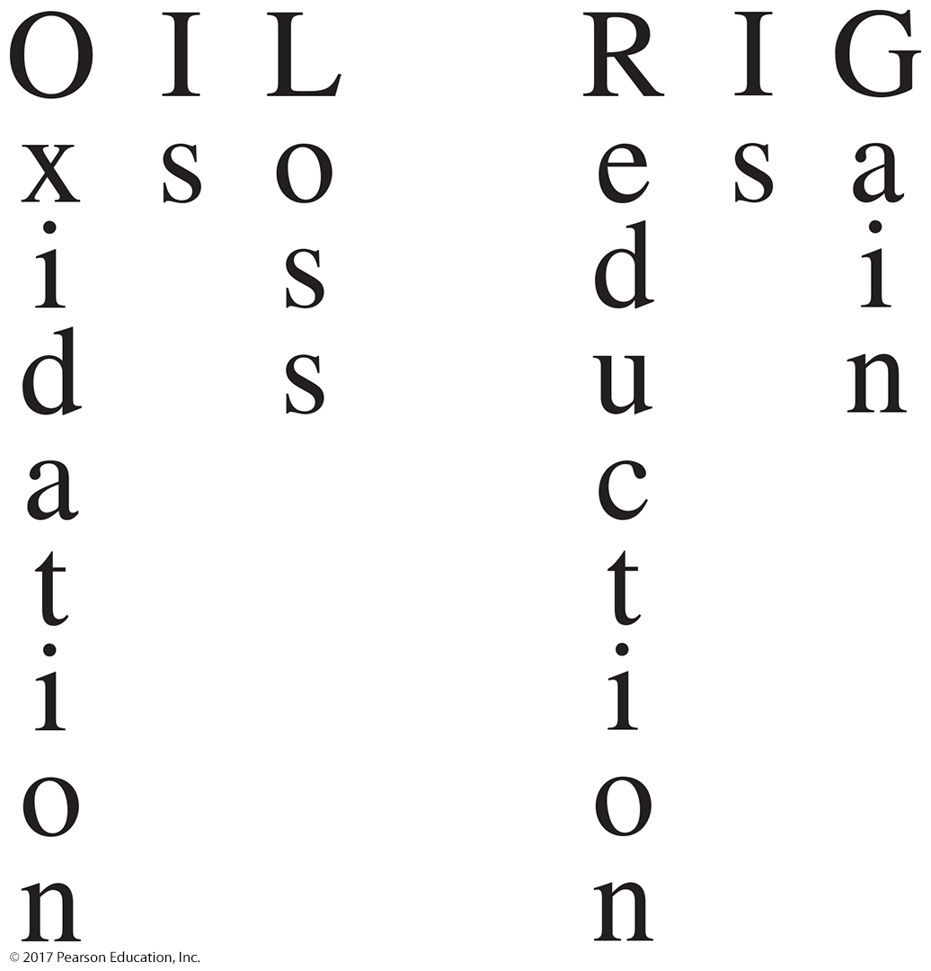
5.4 Oxidation and Reduction
Inorganic Oxidation and Reduction
Metal atoms lose electrons, forming cations (get oxidized).
Nonmetals gain electrons, forming anions (get reduced).
Oxidation and reduction reactions are always coupled.

Slide 34
Learning Check
Identify what is oxidized and what is reduced in this reaction?
Ca(s) + H₂SO₄(aq) → CaSO₄(aq) + H₂(g)

Slide 35
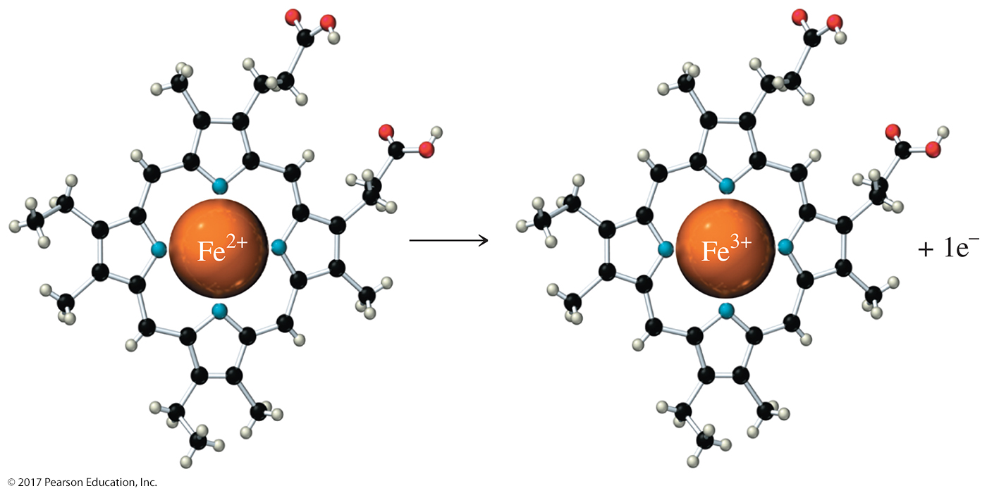
5.4 Oxidation and Reduction
In biological systems, metals are also oxidized and reduced.
A protein called cytochrome c plays an important role in ATP production.
This protein contains an Fe²⁺ that undergoes oxidation to Fe³⁺ followed by reduction back to Fe²⁺. The iron ion is held in place on a small organic molecule called a heme.

Slide 36
5.4 Oxidation and Reduction
Organic Oxidation and Reduction
An organic molecule is oxidized if it gains oxygen or loses hydrogen and is reduced if it gains hydrogen or loses oxygen.
Carbonyl groups can be both reduced and oxidized.

Slide 37
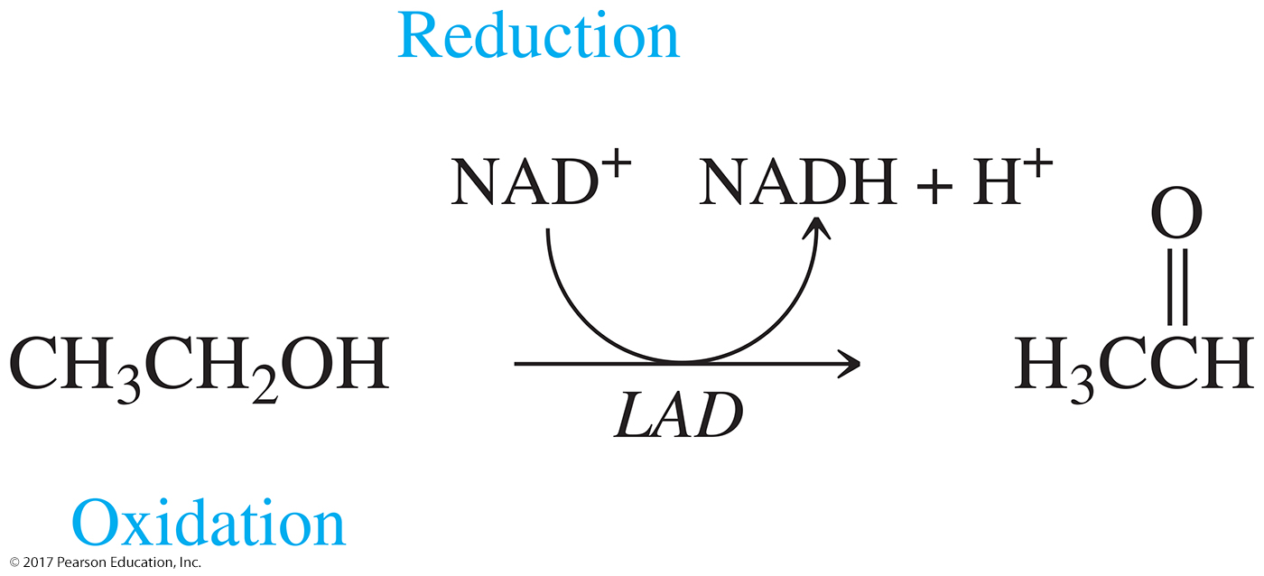
5.4 Oxidation and Reduction
Oxidation in Cells
We fuel our bodies with nutrients that are broken down through oxidation.
In the body, the process of combustion occurs through a chemical pathway, transferring energy as it goes.
NAD⁺ and flavin adenine dinucleotide (FAD) are two important molecules used in metabolic oxidation–reduction reactions.

Slide 38
5.5 Organic Reactions: Condensation and Hydrolysis
In a condensation reaction, water is produced as two organic molecules are joined.
Condensation reactions occur among functional groups that contain an —H and an —OH group that can be removed to form water.
In a hydrolysis reaction (hydro means “water”; lysis means “break”), water is consumed as a reactant and the reactant molecule is split into two smaller molecules.

Slide 39
5.5 Organic Reactions: Condensation and Hydrolysis
Condensation and hydrolysis reactions are common biochemical reactions.
The energy molecule ATP is hydrolyzed to ADP through a hydrolysis.

Slide 40
5.5 Organic Reactions: Condensation and Hydrolysis
Carboxylation reactions involve the addition of a carboxyl, or carboxylic acid, group.

Slide 41
5.5 Organic Reactions: Condensation and Hydrolysis
The addition and removal of phosphate (P_{i}) is one way cells regulate chemical pathways.
These reactions are called phosphorylation and dephosphorylation, and they are a condensation and a hydrolysis reaction, respectively.

Slide 42
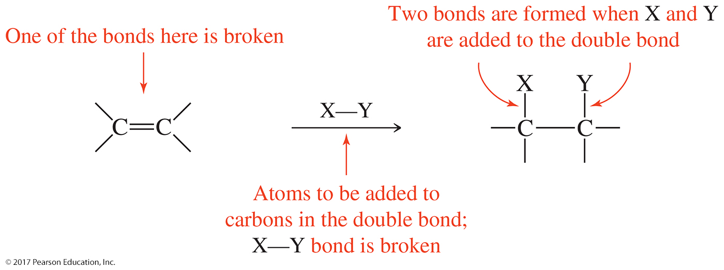
5.6 Organic Addition Reactions to Alkenes
In an addition to an alkene, an atom or group of atoms is added to a double bond in an organic molecule.
The second bond in a double bond is broken and two single bonds are formed.
Atoms are added to the carbons that were in the double bond.

Slide 43
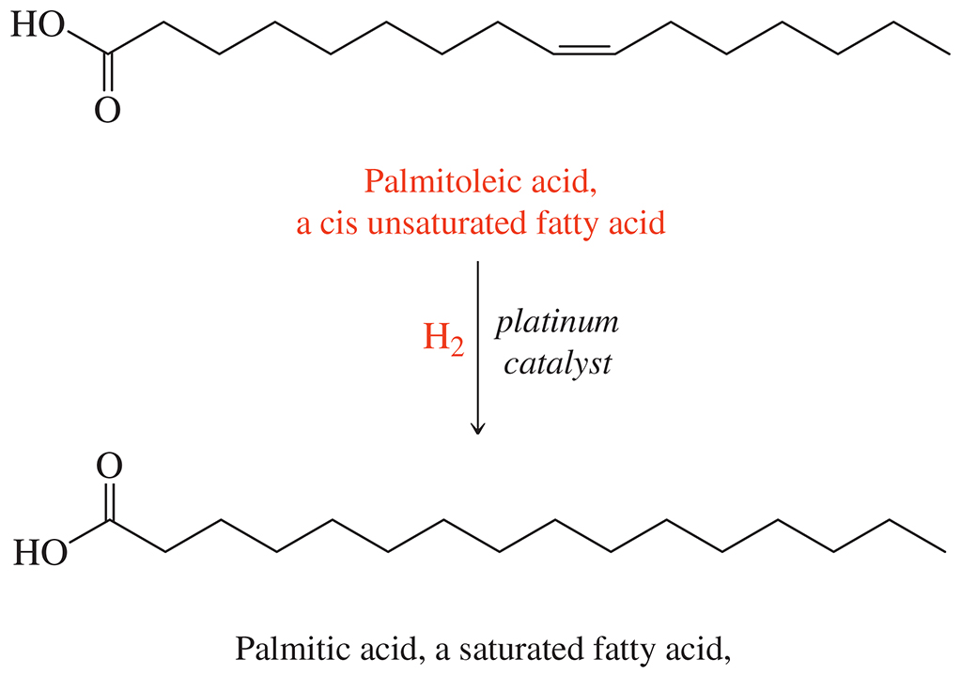
5.6 Organic Addition Reactions to Alkenes
Hydrogenation and Trans Fats
During a hydrogenation reaction, two hydrogen atoms are added, converting an alkene double bond to an alkane single bond.
A catalyst such as platinum (Pt), nickel (Ni), or palladium (Pd) is used.

Slide 44
5.6 Organic Addition Reactions to Alkenes
Hydration
Hydration is the addition of water to the double bond in an alkene.
The water gets added as —H and —OH. This reaction often requires a catalyst such as acid or an enzyme.
If the alkene double bond is asymmetric, the —H will bond to the carbon with more hydrogen atoms.
The —OH will bond to the carbon with more carbon groups attached.

Slide 45
Learning Check
What is the most likely product of hydration of CH₃CH=CH₂?

Slide 46
Learning Check
Draw the products of hydration of these alkenes.

Slide 47
Learning Check
Identify these organic reactions

Slide 49
We discussed many different types of reactions. I would recommend that you make a study guide or flash cards to help you distinguish the difference between them.
Synthesis, Decomposition, Single Exchange, Double Exchange, Combustion, Inorganic Redox, Organic Redox, Condensation, Hydrolysis, Phosphorylation, Carboxylation, Hydrogenation, and Hydration.

Slide 51
Chapter 5 Study Guide
5.1 Thermodynamics
Investigate the properties of heat and energy.
Draw reaction energy diagrams for exergonic and endergonic reactions.
Calculate the energy content in food from its nutrient molecules.

Slide 52
Chapter 5 Study Guide (continued)
5.2 Chemical Reactions: Kinetics
Examine the factors that affect the rate of a chemical reaction.
Determine the effect that temperature, amount of reactants, and a catalyst have on the rate of a reaction.
Recognize that enzymes are biological catalysts.

Slide 53
Chapter 5 Study Guide (continued)
5.3 Overview of Chemical Reactions
Categorize chemical reactions by type.
Classify reactions as synthesis, decomposition, or exchange reactions.
Predict the products of a synthesis, decomposition, or exchange reaction.
Distinguish reversible and irreversible reactions.
Predict the products and balance the chemical equation for a hydrocarbon undergoing combustion.
Contrast a general chemical equation and an organic chemical equation.

Slide 54
Chapter 5 Study Guide (continued)
5.4 Oxidation and Reduction
Distinguish oxidation–reduction reactions in both inorganic and organic chemical reactions.
Identify the substance oxidized and the substance reduced in an inorganic oxidation–reduction reaction.
Identify the substance oxidized and the substance reduced in an organic oxidation–reduction reaction.

Slide 55
Chapter 5 Study Guide (continued)
5.5 Organic Reactions: Condensation and Hydrolysis
Characterize the organic reactions of condensation and hydrolysis.
Predict the products of an organic condensation reaction.
Predict the products of an organic hydrolysis reaction.
Identify organic reactions as oxidation, reduction, condensation, or hydrolysis.

Slide 56
Chapter 5 Study Guide (continued)
5.6 Organic Addition Reactions to Alkenes
Demonstrate how small molecules are added to alkenes.
Predict the products of a hydrogenation reaction, an addition reaction of an alkene.
Predict the products of a hydration reaction, an addition reaction of an alkene.

Slide 57
Additional Practice Problems and Videos
Book –
YouTube-
Types of Simple Reactions- Stop at Combustion Reactions. We will get to Acid-Base later.
https://www.youtube.com/watch?v=z0187f8gqfU
Organic Reactions-
https://www.youtube.com/watch?v=iUvquC4tCP4
Chemical Kinetics- Rate of Reaction
https://www.youtube.com/watch?v=4SK4IlQjZZ4
Exothermic vs. Endothermic Reactions-
https://www.youtube.com/watch?v=eJXL0IrbtqE
Chapter | Page | Questions | Answers on
5 | 210 | 39, 47, 49, 55, 61, 63 | 214

