Slide 1
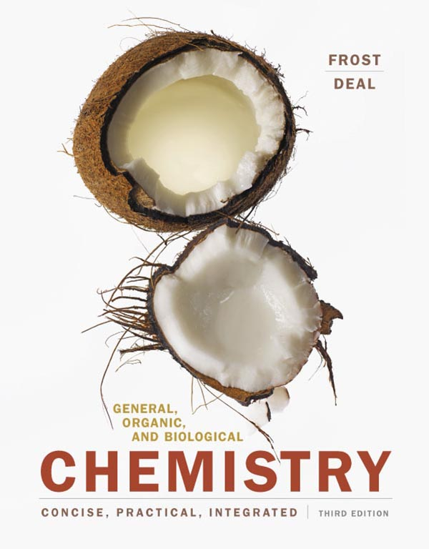
Chapter 3 Compounds—How Elements Combine

Slide 2
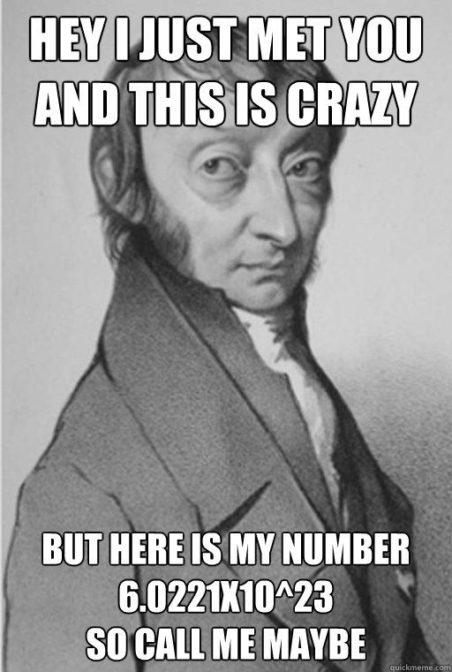
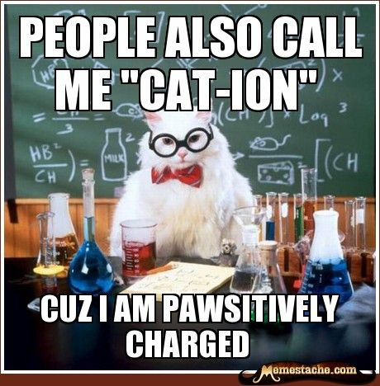
Announcements
Don’t forget to do your Mastering Chemistry Homework!

Slide 3
Outline
3.5 The Mole: Counting Atoms and Compounds
3.1 Electron Arrangements and the Octet Rule
3.2 In Search of an Octet, Part 1: Ion Formation
3.3 Ionic Compounds—Electron Give and Take
3.4 In Search of an Octet, Part 2: Covalent Bond Formation
3.6 Getting Covalent Compounds into Shape
3.7 Electronegativity and Molecular Polarity
© 2017 Pearson Education, Inc.

Slide 4
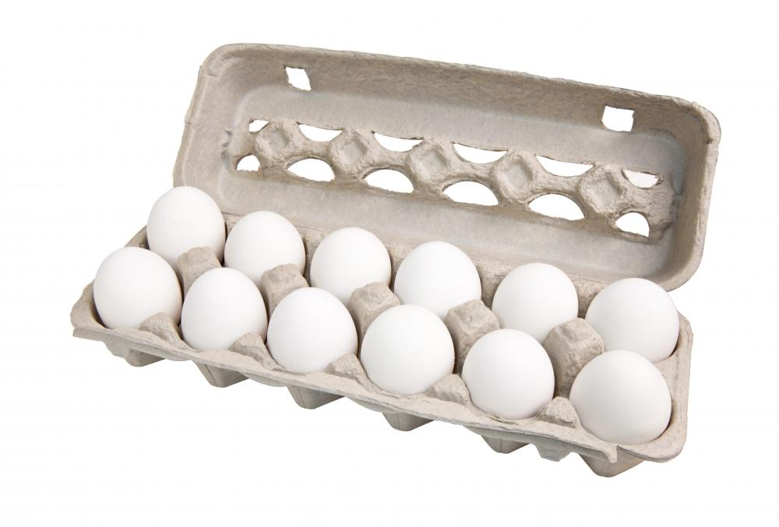
3.5 The Mole: Counting Atoms and Compounds
Chemists use a unit called the mole to relate the mass of an element in grams to the number of atoms it contains.
The mole is a unit for counting atoms just as a dozen is a unit for counting things such as eggs.
The number of eggs in 1 dozen is 12.

Slide 5
3.5 The Mole: Counting Atoms and Compounds
The number of atoms present in one mole is about 602,000,000,000,000,000,000,000.
The number of atoms in a mole can be better represented in scientific notation as 6.02 × 10²³.
This is known as Avogadro’s number (N) in honor of the Italian physicist Amedeo Avogadro.
6.02 × 10²³ atoms = 1 mole of atoms

Slide 6
3.5 The Mole: Counting Atoms and Compounds
Avogadro’s number can be used as a conversion factor to convert between atoms and moles.

Slide 7
Learning Check
How many moles are 8.66 x 10⁵⁶ atoms?
2. How many atoms are in 6.3 moles of iron?

Slide 8
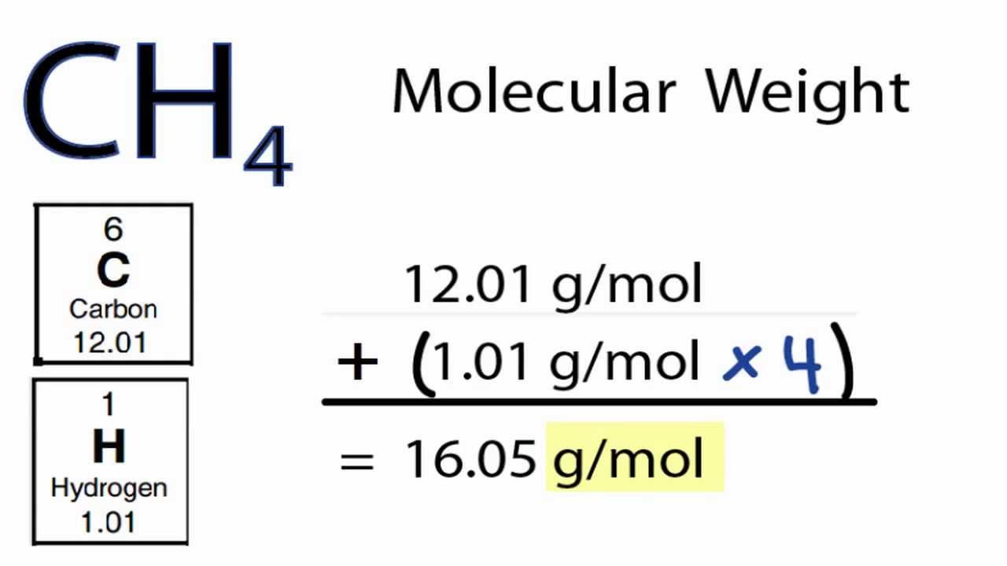
3.5 The Mole: Counting Atoms and Compounds
The formula weight for a compound is the sum of the atomic masses.
The molar mass of a compound is numerically equal to the formula weight with units of grams/mole.

Slide 9
Learning Check
Calculate the molar masses of:
H₂O
NH₃
C₁₂H₂₂O₁₁

Slide 10
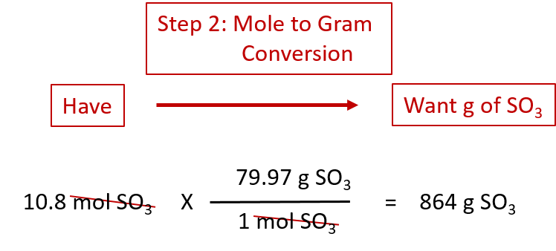
Using Molar Mass as a Conversion Factor
Question: How many grams of SO₃ are in 10.8 moles of SO₃?
Step 1: Find Molar Mass of SO₃.

Slide 11
Learning Check
How many moles are in 28.5g of H₂O?
How many grams are in 4.8mol of NH₃?

Slide 12
Learning Check
When should you use molar mass in a calculation versus when should you use Avogadro's Number?

Slide 13
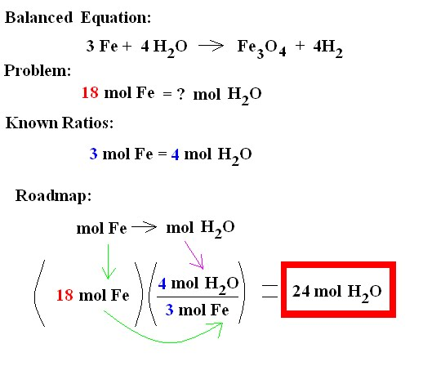
Mole to Mole Relationships

Slide 14
Learning Check
How many moles of H₂ would be produced from 6.2 moles of Fe?

Slide 15
3.1 Electron Arrangements and the Octet Rule
Electrons exist only at distinct energy levels (steps on the staircase), not in between.
In general, electrons will occupy the lowest energy step first.
The lowest energy level is found closest to the nucleus.
Unlike a real staircase, the energy levels get closer together the farther you get from the nucleus.
The arrangement of electrons around an atom is one of the reasons elements form compounds.
The exact location of any given electron outside the nucleus is difficult to determine, but most of them lie within an electron cloud.
Because electrons are charged and are in constant motion, they possess energy.

Slide 16
3.1 Electron Arrangements and the Octet Rule
The highest energy level that contains electrons is the valence shell. The electrons in it are valence electrons.
Valence electrons are farthest from the nucleus.
These electrons combine when elements make compounds.
Groups indicate the number of valence electrons in atoms for the main-group elements.
Elements with the same number of electrons in their highest energy level are in the same group on the periodic table.
Boron (B) and aluminum (Al) have three electrons in their highest energy level. Both are in Group 3A.

Slide 17
Learning Check
How many valence electrons do the following elements have?
Be
F
S
Al

Slide 18
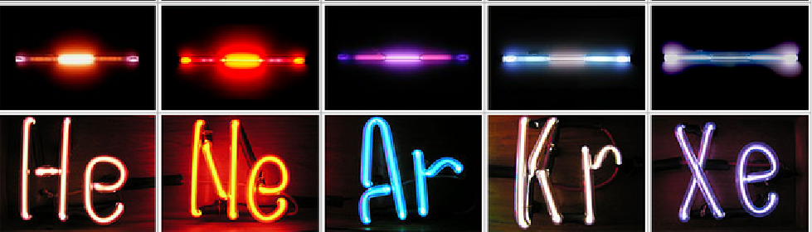
3.1 Electron Arrangements and the Octet Rule
Elements in Group 8A, the noble or inert gases, are unreactive under all but extreme conditions.
The noble gases (8A) have eight valence electrons (except for helium, which has only two valence electrons). Possessing eight valence electrons is a highly stable state for an atom.
Most atoms will react with other atoms to achieve eight electrons in their valence shell. This is the octet rule.
To achieve a valence octet, some atoms give away electrons, others accept or take electrons, and others share electrons.

Slide 19
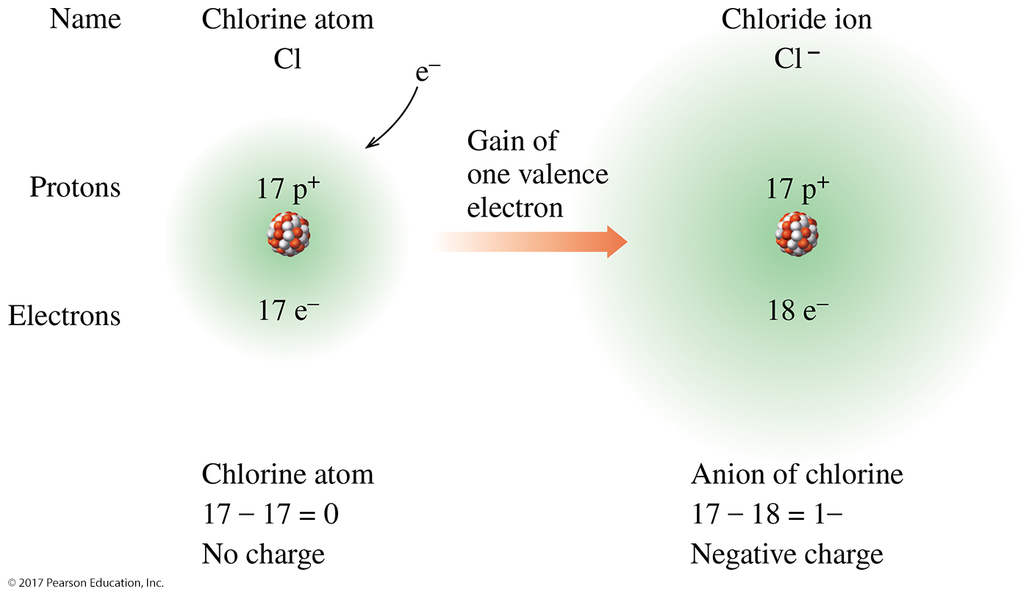
3.2 In Search of an Octet, Part 1: Ion Formation
If an atom gains or loses electrons to achieve an octet, this newly formed particle would have an unequal number of protons and electrons and a net charge. These charged atoms are ions.
Ions formed when atoms gain electrons and become negatively charged are called anions.

Slide 20
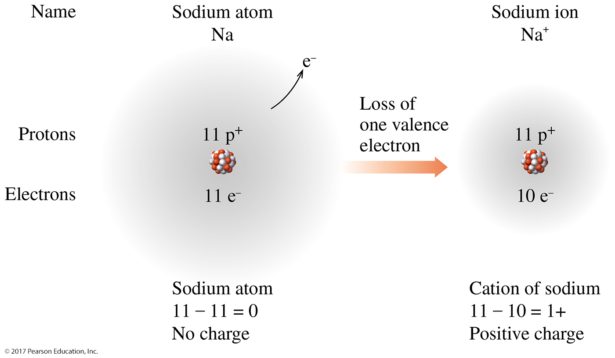
3.2 In Search of an Octet, Part 1: Ion Formation
The ion is more stable than the atom because it has satisfied the octet rule.
Ions formed when atoms lose electrons and become positively charged are called cations.

Slide 21
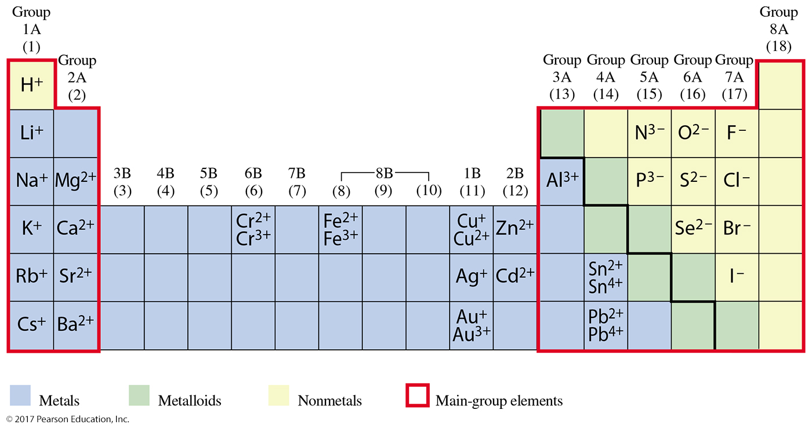
3.2 In Search of an Octet, Part 1: Ion Formation

Slide 22
Learning Check
Give the charge that each of the following would have if they had their octet?
Be
F
S
Al

Slide 23
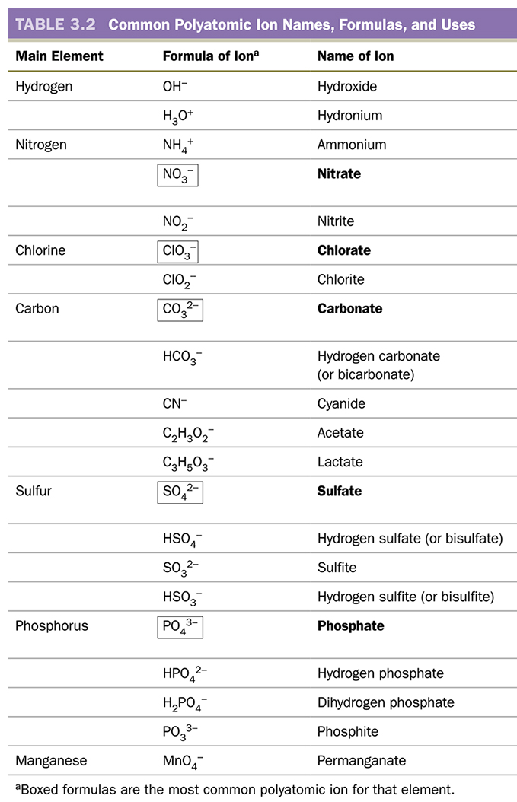
3.2 In Search of an Octet, Part 1: Ion Formation
Polyatomic ions consist of a group of nonmetals that form an ion. The charge is for the entire group of atoms.

Slide 24
3.2 In Search of an Octet, Part 1: Ion Formation

Slide 25
3.2 In Search of an Octet, Part 1: Ion Formation
Naming Ions
For metal ions, add the word ion to the name of the metal: Na⁺ is sodium ion.
Transition metals that form more than one ion use a Roman numeral in parentheses following the name of the metal to indicate the charge on the ion: Fe²⁺ is iron(II) ion.
For nonmetals, the suffix -ide replaces the last few letters of the name of the element: fluoride.
Most polyatomic ions end in -ate. The ending -ite is used for related ions that have one fewer oxygen atom. Hydroxide (OH–), hydronium (H₃O⁺), and cyanide (CN–) are exceptions to this convention.

Slide 26
3.3 Ionic Compounds—Electron Give and Take
When a metal and a nonmetal combine, electrons are transferred between the atoms, forming oppositely charged ions.
The attraction of cation and anion is called an ionic bond.
The result is an ionic compound.
The number of ions that combine to form an ionic compound is determined by the charge of the cation and the charge of the anion.
Cations and anions combine so that the compound has a net charge of zero.

Slide 27
3.3 Ionic Compounds—Electron Give and Take
Steps to Check a Chemical Formula
STEP 1 Determine the charge of the ions from the periodic table if they are main-group elements.
STEP 2 Combine the ions in a formula so that the total charge present sums to zero.
STEP 3 Check your formula by examining the charges on the ions and subscripts in the formula.
Rules to Predict Number and Charge in a Chemical Formula
RULE 1 The formula of a ionic compound has no net charge (+ and – charges add up to zero).
RULE 2 The charge of the anion is known.

Slide 28
Learning Check
What would the resulting compound be for these combinations of elements?
Mg and Br
Na and S

Slide 29
3.3 Ionic Compounds—Electron Give and Take
Naming Ionic Compounds
To name an ionic compound, the names of the two ions are combined, cation first. The word ion is omitted: NaCl is sodium chloride.
For transition metals, a Roman numeral is used to designate the charge: CuO is copper(II) oxide.
If a polyatomic ion is present, the name of the ion remains unchanged in the name of the compound: Ca₃(PO₄)₂ is calcium phosphate.

Slide 30
Learning Check
In your own words, write down the naming rules for Ionic Compounds.

Slide 31
Learning Check
Name the following compounds.
Na₂O
CuCl₂
ZnNO₃

Slide 32
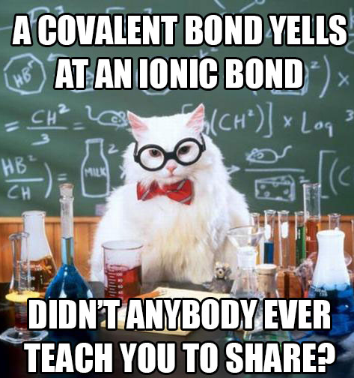
Covalent Compounds

Slide 33
3.4 In Search of an Octet, Part 2: Covalent Bond Formation
Nonmetals combine by sharing valence electrons to achieve an octet.
Sharing of electrons results in the formation of a covalent bond.
The valence electrons in the bond belong to both of the atoms.
When atoms share, the result is a covalent compound.
The smallest (or fundamental) unit of a covalent compound is a molecule.

Slide 34
3.4 In Search of an Octet, Part 2: Covalent Bond Formation
The number of covalent bonds that an atom will form equals the number of electrons necessary to complete its octet.
The electron-dot symbol for any atom consists of the elemental symbol plus a dot for each valence electron.
A shared pair of electrons, a bonding pair or simply a bond, is represented as a dash or line connecting the two electron-dot symbols.
Each of the atoms in the newly formed molecule now has an octet.

Slide 35
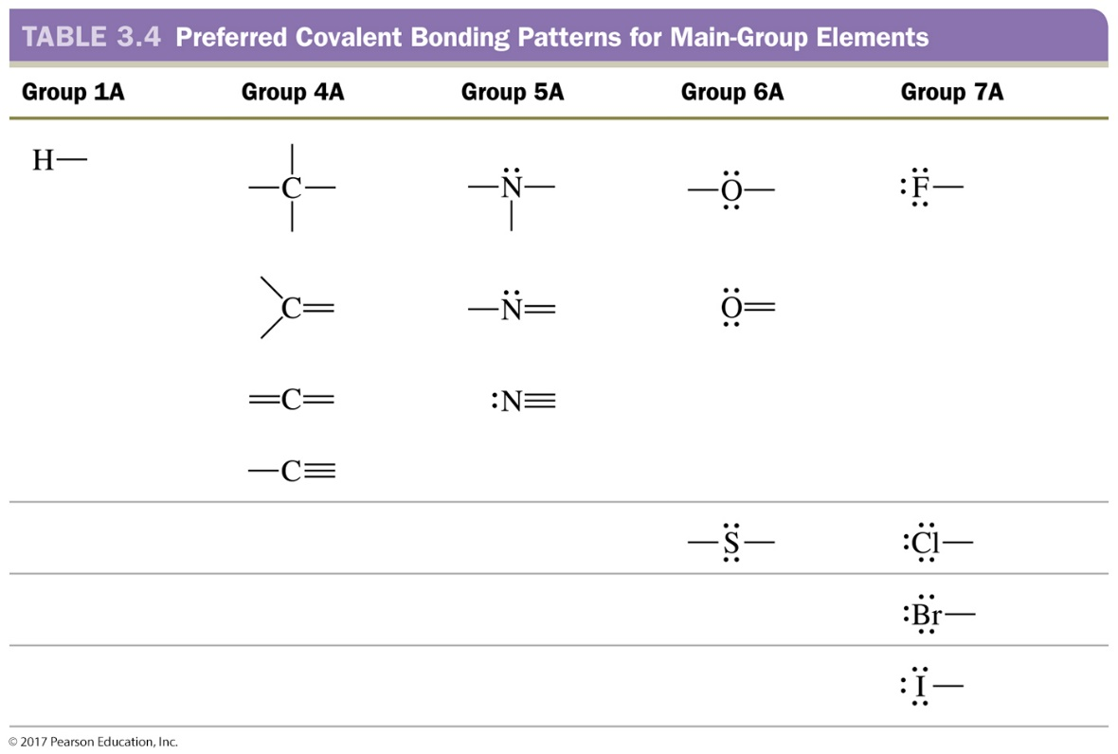
3.4 In Search of an Octet, Part 2: Covalent Bond Formation
Carbon must form four covalent bonds to complete its octet.
It can form four single bonds, or
It can form double bonds by sharing two electrons with one other atom, or
It can share three electrons with one other atom to form a triple bond.

Slide 36
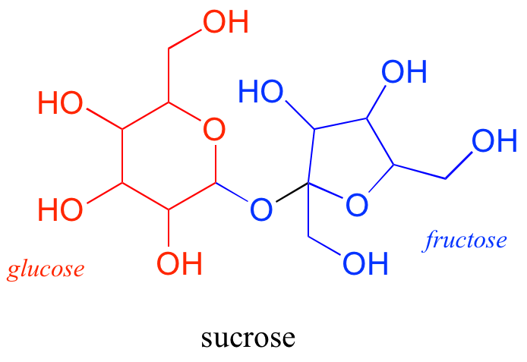
3.4 In Search of an Octet, Part 2: Covalent Bond Formation
Formulas and Structures of Covalent Compounds
The molecular formula for a covalent compound identifies all the components in a molecule.
Glucose has the formula C₆H₁₂O₆. This tells us that a molecule of glucose has 6 carbon atoms, 12 hydrogen atoms, and 6 oxygen atoms.
The formula does not show the structure. The electron-dot symbols help us visualize the structure.

Slide 37
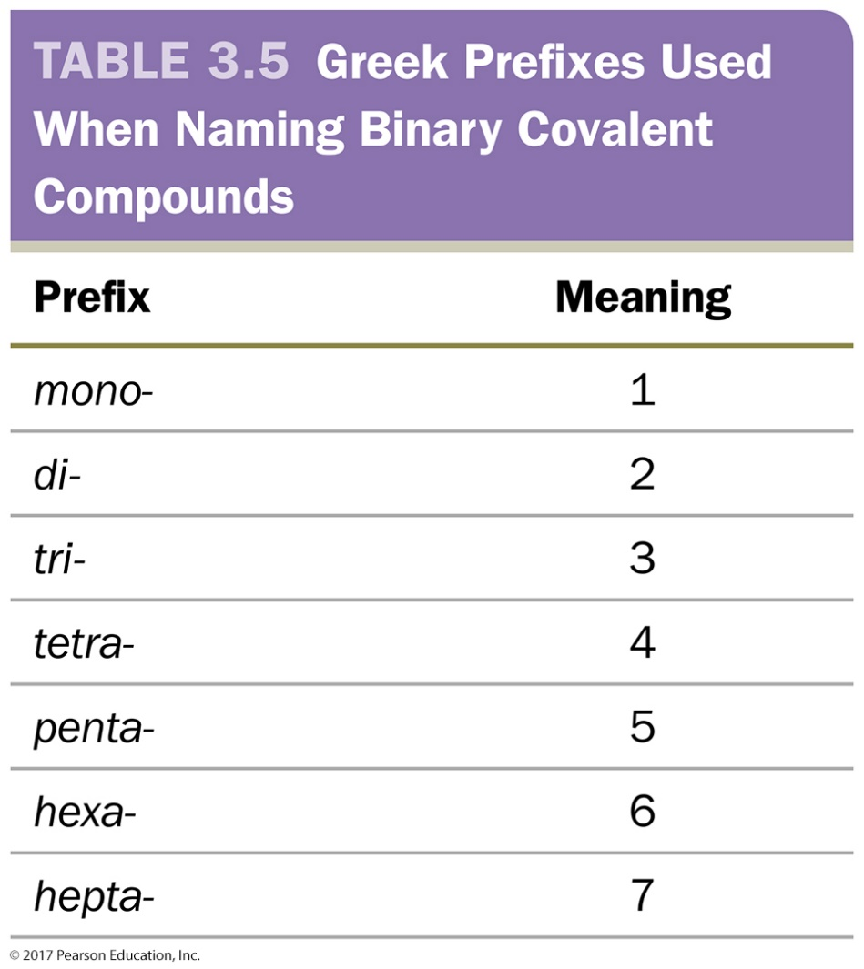
3.4 In Search of an Octet, Part 2: Covalent Bond Formation
Naming Covalent Compounds
Binary compounds are composed of only two elements and can be named by a three-step procedure.
Name the first element in the formula.
Name the second element in the formula and change the ending to -ide.
Designate the number of each element present using one of the Greek prefixes.

Slide 38
Learning Check
What is the difference between Ionic and Covalent Compounds? How can you identify them?

Slide 39
Learning Check
In your words, write down the rules for naming Covalent Compounds

Slide 40
Learning Check
Name the following compounds.
H₂O
CO₂
NH₃

Slide 41
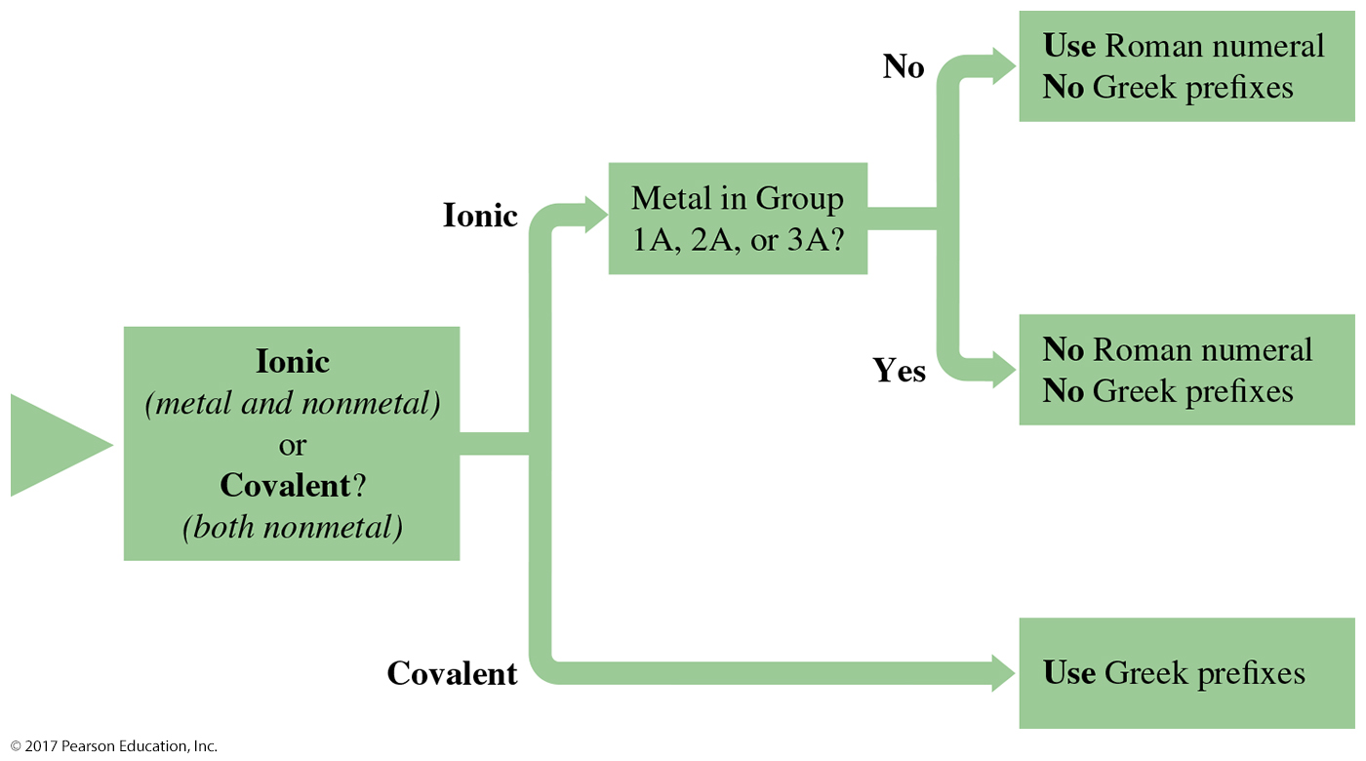
3.4 In Search of an Octet, Part 2: Covalent Bond Formation

Slide 42
3.4 In Search of an Octet, Part 2: Covalent Bond Formation
Formulas and Structures of Covalent Compounds
Methane, with a molecular formula of CH₄, is a covalent compound (all nonmetals).
Carbon must make four bonds to complete its octet. Each hydrogen atom will make one bond. Connecting the atoms fulfills these requirements.
This representation is called a Lewis structure.

Slide 43
Learning Check
Lewis Structure Activity in Lab with Model Kits.
I’m going to walk you through 2 examples. You will get a lot more practice in lab.

Slide 44
Examples
Exceptions to the Octet Rule
Element | Number of Electrons | Number of Bonds
H | 2 | 1
Be | 4 | 2
B | 6 | 3
CO₂
NH₃
Count the number of valence electrons for the compound.
Write the “skeleton” structure with single bonds.
Place any remaining electrons in pairs on the outside atoms until they reach their octet.
Place any remaining electrons on the center atoms.
Check Octet for each atom in the compound.
If there is an atom(s) that don’t meet the octet, remove a pair and make it a double bond.
Double check octets and total number of electrons.

Slide 45
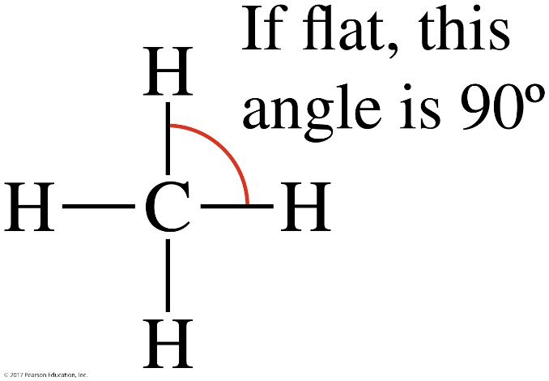
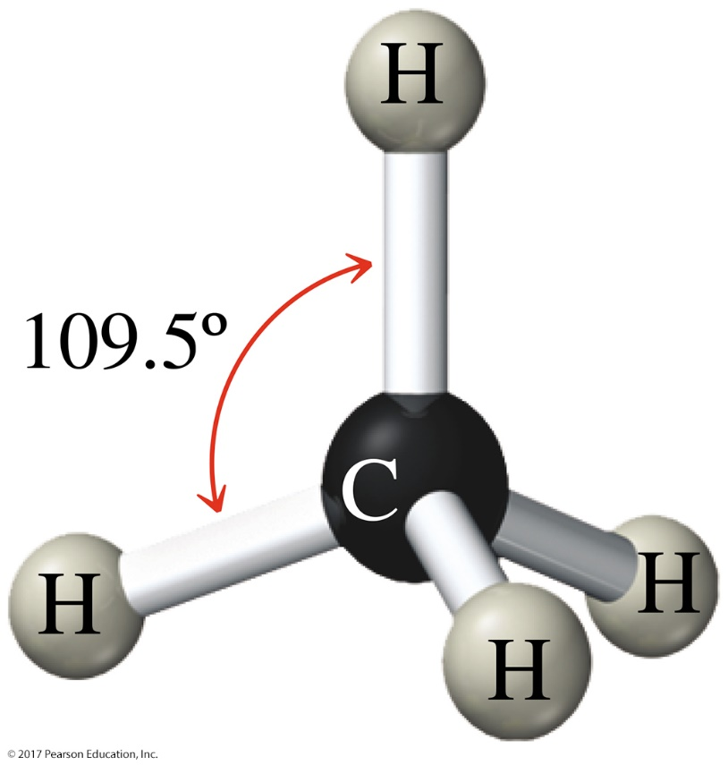
3.6 Getting Covalent Compounds into Shape
The Lewis structure for methane (CH₄) appears flat on paper, with 90° bond angles.
If the electrons rearrange in three-dimensional space to get as far apart as possible, the molecule is tetrahedral.

Slide 46
3.6 Getting Covalent Compounds into Shape
Wedges and dashes are a simpler way to represent a three-dimensional structure.
Wedges indicate in-front-of-the-plane; dashes indicate behind-the-plane.

Slide 47
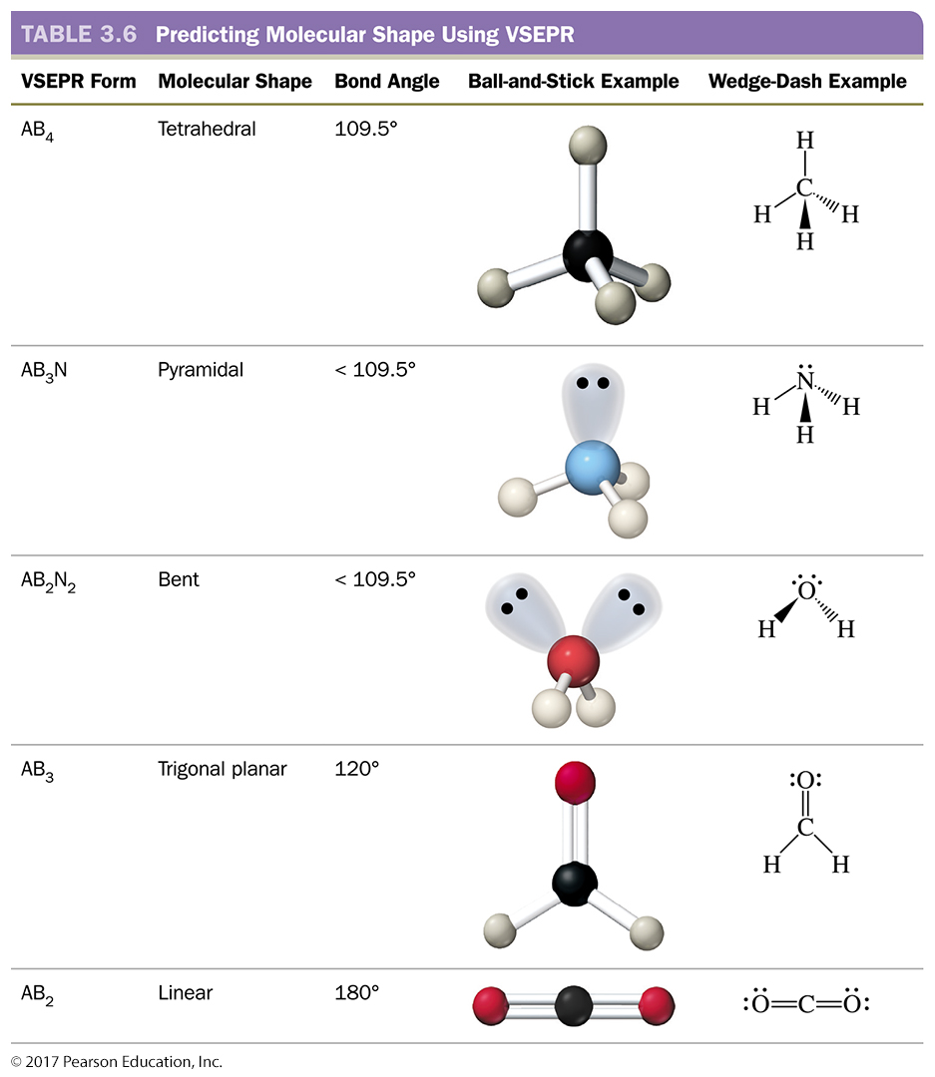
3.6 Getting Covalent Compounds into Shape

Slide 48
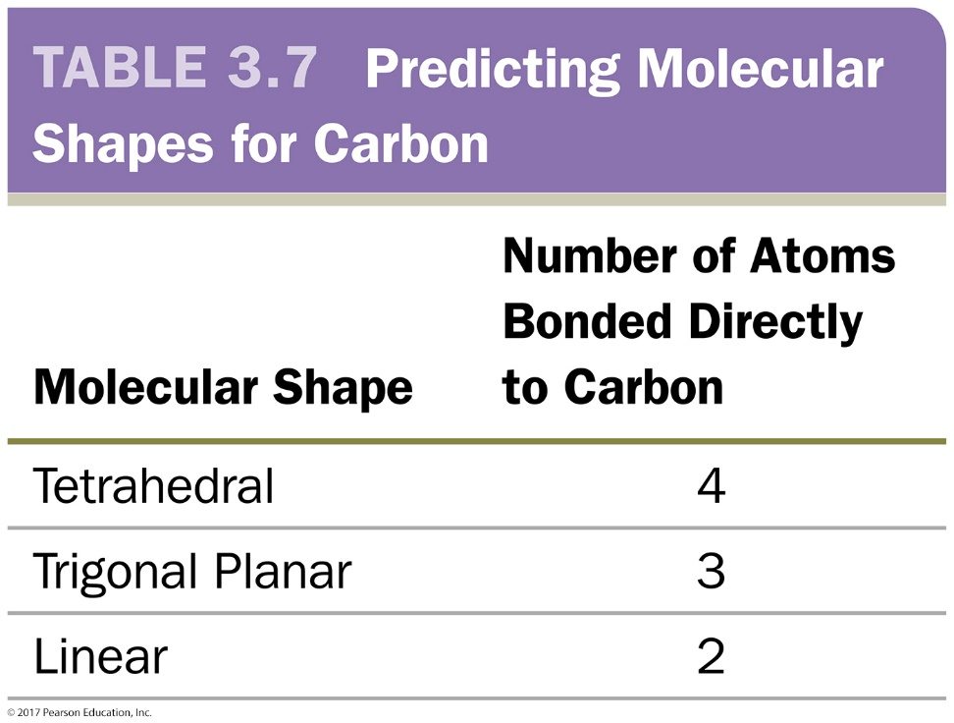
3.6 Getting Covalent Compounds into Shape
Carbon
If four atoms are bonded to a carbon, the shape is tetrahedral; if three atoms, the shape is trigonal planar; and if two atoms, the shape is linear.

Slide 49
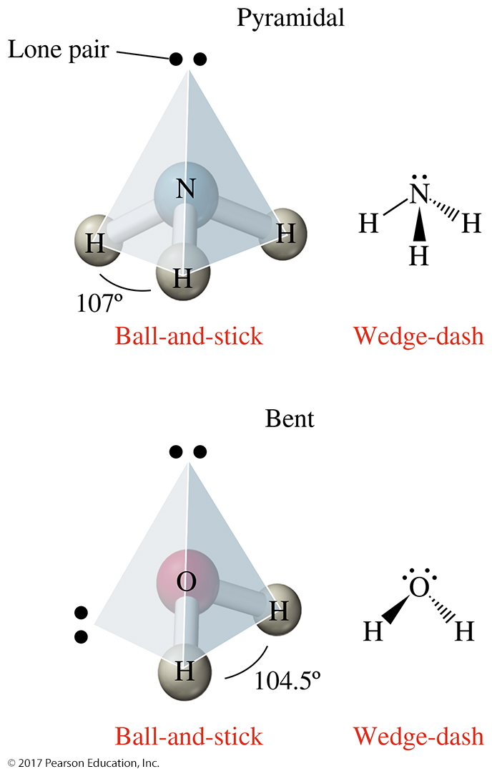
3.6 Getting Covalent Compounds into Shape
Nonbonded pairs of electrons take up space but are invisible in the molecule’s shape.
A nonbonded pair of electrons forces bonded pairs closer together.
Bonded electrons are confined between two atoms.
Nonbonded electrons are not restricted in this way and take up more space.

Slide 50
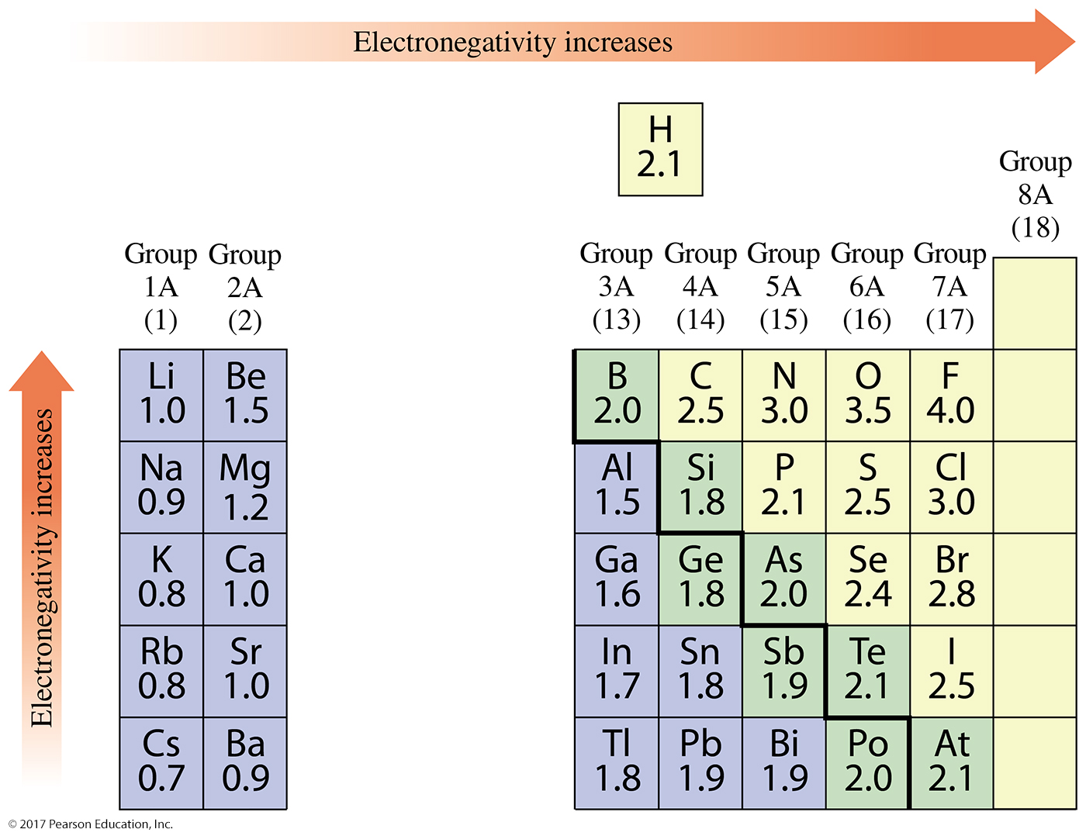
3.7 Electronegativity and Molecular Polarity
Electronegativity
The ability of an atom to attract the bonding electrons of a covalent bond to itself is known as electronegativity.
The element with the greatest electronegativity on the periodic table is fluorine.
Electronegativity increases as you move closer to fluorine.

Slide 51
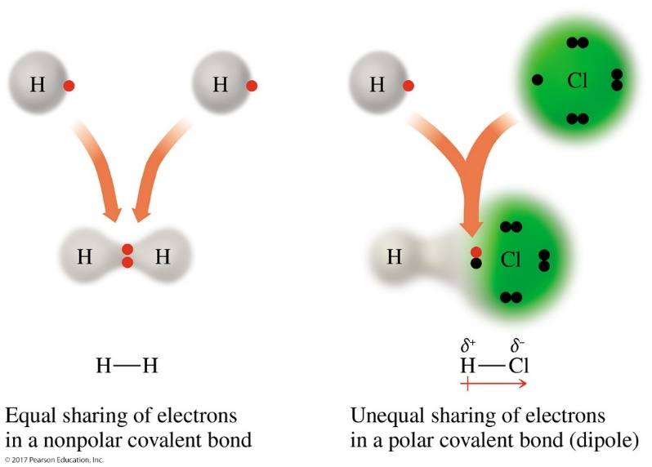
3.7 Electronegativity and Molecular Polarity
Inequality occurs when two different atoms are involved in the covalent bond; the electrons are shared unequally and is a polar covalent bond
When two identical atoms share electrons to form a covalent bond, the electrons are shared equally and is a nonpolar covalent bond.

Slide 52
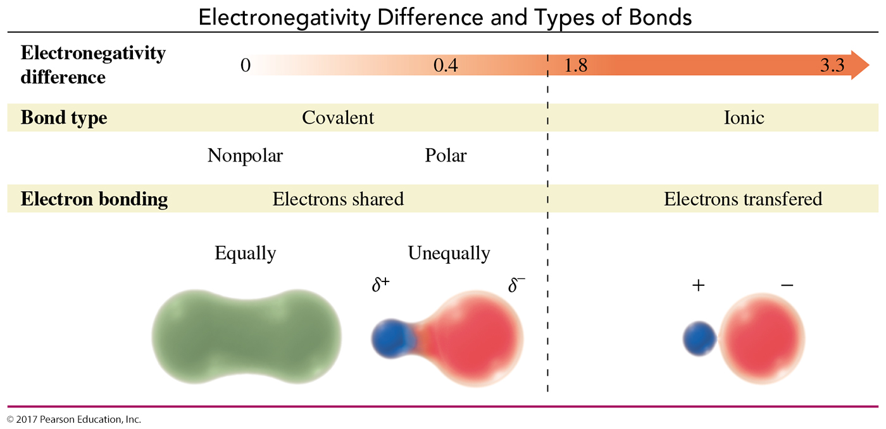
3.7 Electronegativity and Molecular Polarity
A covalent bond that does not share electrons equally has one end that is partially negative (δ⁻) and one that is partially positive (δ⁺).
These bonds are polar.
A bond that is “nonpolar”(sharing equally) has no ends or poles.
The greater the electronegativity difference, the more polar the bond.

Slide 53
3.7 Electronegativity and Molecular Polarity
It is possible to distinguish ionic bonds from covalent bonds by looking at the types of elements present (metals vs. nonmetals).
The farther apart two nonmetals are on the periodic table, the greater the polarity of the bond between them.
One major exception to this rule: C—H bonds are nonpolar, because their electronegativities are similar.

Slide 54
3.7 Electronegativity and Molecular Polarity
Molecular Polarity
Molecules can be polar or nonpolar.
A polar molecule has an uneven distribution of electrons over the molecule.
A nonpolar molecule has an even distribution of electrons over the entire molecule.
When a molecule is composed of three or more atoms connected by several bonds, we must consider both the electronegativity of the atoms involved and the shape of the molecule.

Slide 55
3.7 Electronegativity and Molecular Polarity
Each molecule has two polar bonds, but carbon dioxide is a nonpolar molecule, whereas water is a polar molecule.
Carbon dioxide is a linear molecule, but water is bent.

Slide 57
Additional Practice Problems
How many moles are in 1.29 x 10²⁴ molecules of HF?
How many moles of carbon tetrafluoride, CF₄, are in 176 grams of CF₄?
How many atoms are in a 3.56 g sample of Cu?
If 2.5 moles of H₂O are produced in the following reaction, how many moles of hydrogen gas must be used? 2 H₂ + O₂ → 2 H₂O

Slide 58
Additional Practice Problems
The following 2 questions have both ionic and covalent compounds. Determine which are which then answer the questions.
Name the following compounds: CaCO₃, P₄S_{3,} NaBr, SF_{6,} Cu₂O
What is the formula for the following compounds? dinitrogen monoxide, calcium bromide, iron (II) phosphate, nonacarbon pentahydride

Slide 59
Additional Practice Problems
I would highly recommend that you redo the Lewis structure lab activity for practice on drawing Lewis structures and understanding polarity.

Slide 61
Chapter 3 Study Guide
3.1 Electron Arrangements and the Octet Rule
Arrange electrons in shells surrounding an atom.
Predict the number of valence electrons and energy level for the main-group elements in the first four periods.
Explain and apply the octet rule.
3.2 In Search of an Octet, Part 1: Ion Formation
Apply the octet rule to ion formation.
Predict the ionic charge of a main-group element using the periodic table.
Write symbols for ions given their name or the number of protons and electrons present.
Gain familiarity with polyatomic ions and their charges. Memorize the boxed bolded ones in the table.

Slide 62
Chapter 3 Study Guide (continued)
3.3 Ionic Compounds—Electron Give and Take
Combine ions forming ionic compounds. Name ionic compounds given the formula.
Give the formula and name of an ionic compound given the ions.
Write the formula for ionic compounds given the name.
Predict the ionic charges present in an ionic compound.
Predict the ionic charge of a transition metal using the compound’s formula and the anionic charge.

Slide 63
Chapter 3 Study Guide (continued)
3.4 In Search of an Octet, Part 2: Covalent Bond Formation
Combine atoms forming covalent compounds.
Distinguish between ionic and covalent compounds.
Establish the relationship between the number of valence electrons present in nonmetals in Periods 1–3 and the number of bonds they typically make in a molecule.
Draw Lewis structures for covalent compounds containing C, O, N, H, and the halogens (Group 7A).
Name binary covalent compounds given the formula.
Write the formula for a binary covalent compound given the name.

Slide 64
Chapter 3 Study Guide (continued)
3.5 The Mole: Counting Atoms and Compounds
Calculate the number of moles and number of atoms in a substance.
Describe the mole and Avogadro’s number.
Calculate molar mass for a compound.
Convert among the units of mole, number of particles, and gram.
Use mole to mole ratios

Slide 65
Chapter 3 Study Guide (continued)
3.6 Getting Covalent Compounds into Shape
Identify the location of a wedge-and-dash bonded atom in three-dimensional space.
Predict the molecular shapes of atoms in Lewis structures.
3.7 Electronegativity and Molecular Polarity
Predict the molecular polarity of covalent compounds.
Predict covalent bond polarity based on electronegativity.
Predict molecular polarity from bond polarities and molecular shape.

Slide 66
Additional Practice Problems and Videos
Book –
YouTube- Moles
Avogadro’s Number-
https://www.youtube.com/watch?v=jHbocq7n1Ew
Molar Mass-
https://www.youtube.com/watch?v=TFbGLEZ4qt0
Mole to Mole Ratios-
https://www.youtube.com/watch?v=c9beXPzJ-Fs
Chapter | Page | Questions | Answers on
3 | 118 | 55, 57, 59, 65, 73, 75, 83, 93, 95, 97, 105 | 122
YouTube-
Compound Naming-
https://www.youtube.com/watch?v=nijb6UMvZuE
Lewis Structures-
https://www.youtube.com/watch?v=cIuXl7o6mAw
Polarity-
https://www.youtube.com/watch?v=72CQe-_PJU4

