Slide 1
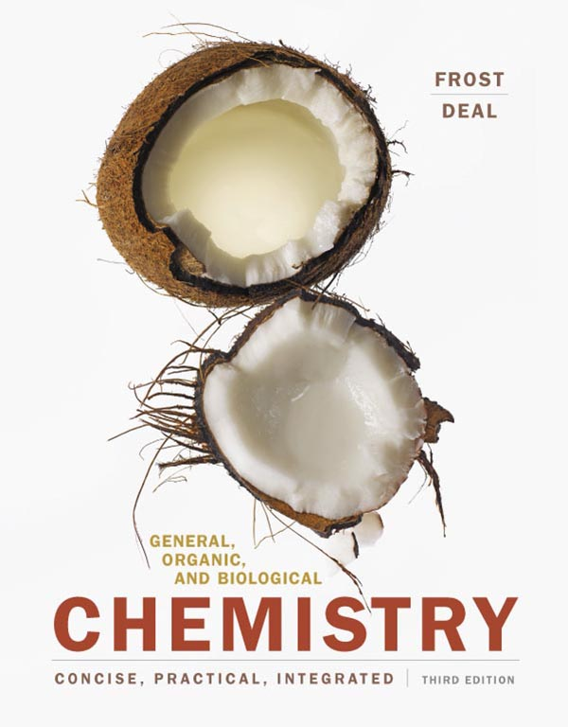
Chapter 10 Proteins—Workers of the Cell

Slide 2
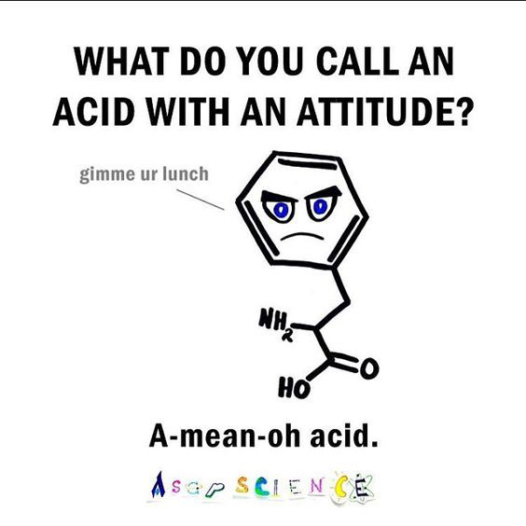
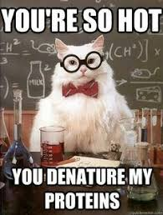
Announcements
Don’t forget to do your Mastering Chemistry Homework!
LAST CHAPTER!

Slide 3
Outline
10.1 Amino Acids—A Second Look
10.2 Protein Formation
10.3 The Three-Dimensional Structure of Proteins
10.4 Denaturation of Proteins
10.5 Protein Functions
10.6 Enzymes—Life’s Catalysts
10.7 Factors That Affect Enzyme Activity
© 2017 Pearson Education, Inc.

Slide 4
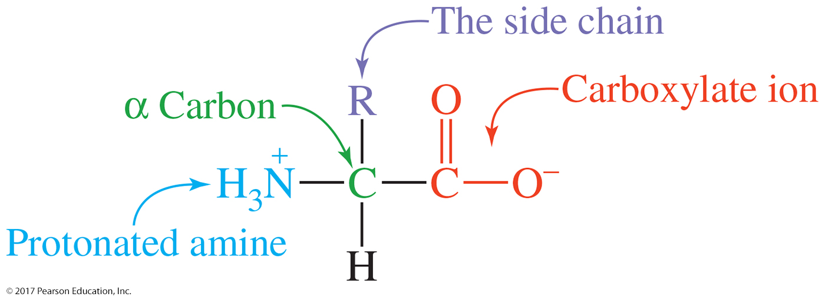
Outline
10.1 Amino Acids—A Second Look
“Amino” indicates a protonated amine (—NH₃⁺).
“Acid” indicates a carboxylic acid (—COO–).
These groups are bonded to a central alpha (α) carbon atom and are referred to as the alpha (α) amino and alpha (α) carboxylate groups.
The α carbon is also bonded to a hydrogen atom and a side chain.
© 2017 Pearson Education, Inc.

Slide 5
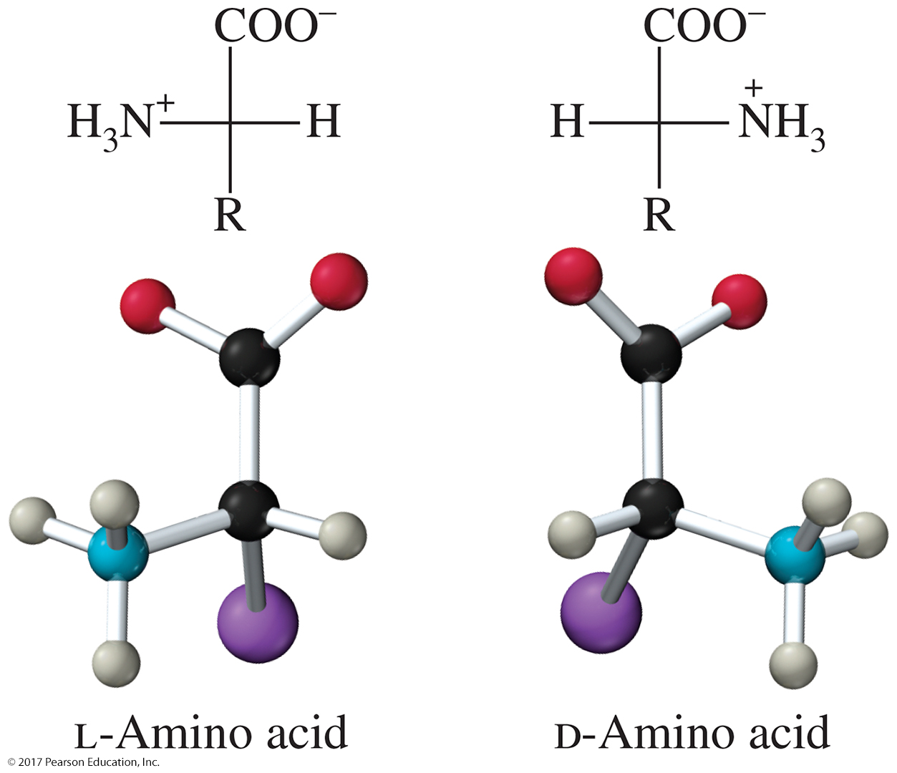
Outline
10.1 Amino Acids—A Second Look
The α carbon is a chiral center in all of the amino acids except glycine.
© 2017 Pearson Education, Inc.

Slide 6
Outline
10.1 Amino Acids—A Second Look
The R group gives each amino acid its unique identity and characteristics.
Twenty amino acids are found in most proteins.
The properties of the functional groups allow them to be classified as nonpolar, polar, acidic, and basic.
The 10 amino acids designated with an asterisk (*) are “essential”—they must be obtained in the diet.
A complete protein meal can be obtained by combining plant foods.
© 2017 Pearson Education, Inc.

Slide 7
Outline
10.1 Amino Acids—A Second Look
Classification of Amino Acids
Amino acids are separated into nonpolar and polar.
Polar amino acid side chains contain functional groups that create an uneven distribution of electrons in the side chain.
Polar acidic and polar basic amino acids have charged side chains, which allow them to form ion–dipole interactions with water.
© 2017 Pearson Education, Inc.

Slide 8
Outline
10.1 Amino Acids—A Second Look
Abbreviations for Amino Acids
Amino acids represent the vocabulary of proteins.
Amino acids have both three-letter and one-letter abbreviations.
Of the 20, 11 abbreviations start with the first letter of the name.
The remaining nine amino acids have abbreviations that start with different letters.
Table 10.2 provides information about the origins of the abbreviations.
© 2017 Pearson Education, Inc.

Slide 9
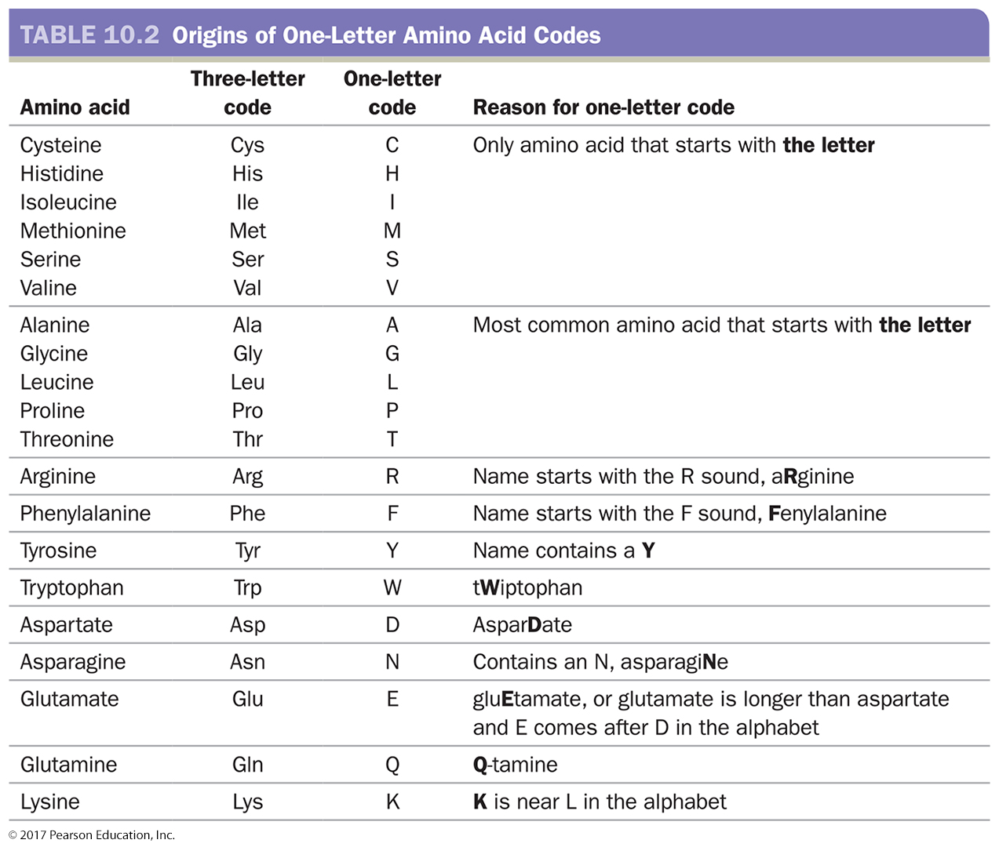
Outline
10.1 Amino Acids—A Second Look
Don’t memorize
© 2017 Pearson Education, Inc.

Slide 10
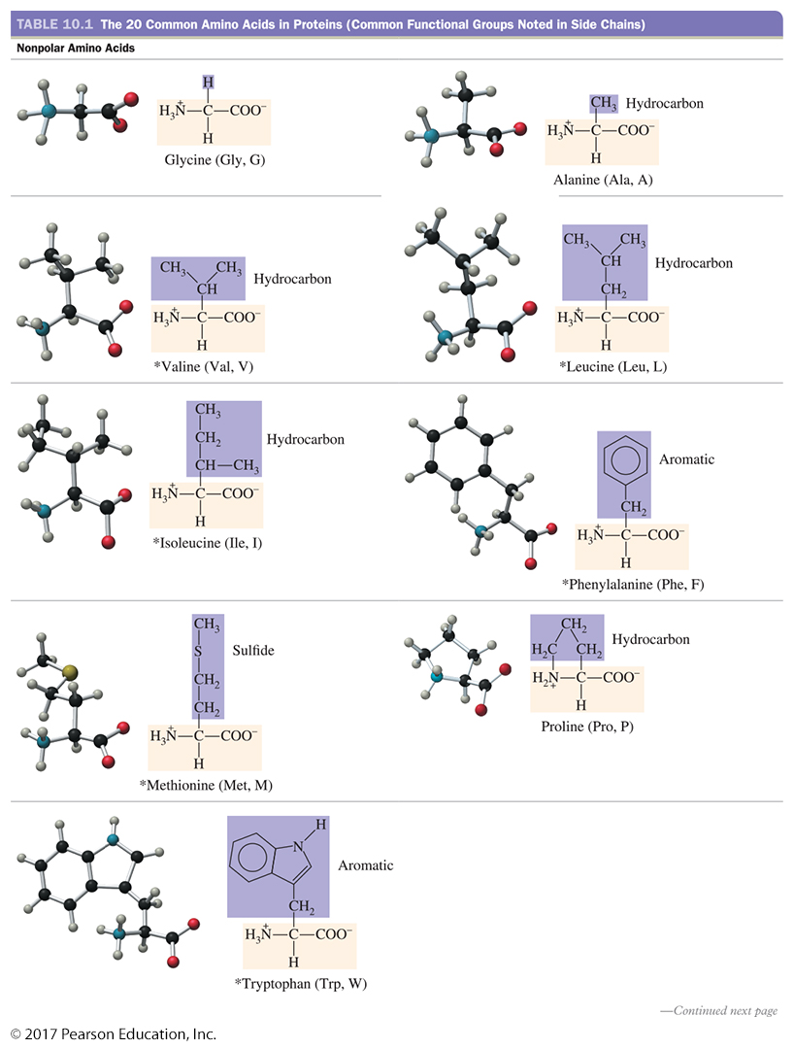
Outline
10.1 Amino Acids—A Second Look
© 2017 Pearson Education, Inc.

Slide 11
Outline
10.1 Amino Acids—A Second Look
© 2017 Pearson Education, Inc.

Slide 12
Outline
10.1 Amino Acids—A Second Look
© 2017 Pearson Education, Inc.

Slide 13
Outline
10.1 Amino Acids—A Second Look
© 2017 Pearson Education, Inc.

Slide 14
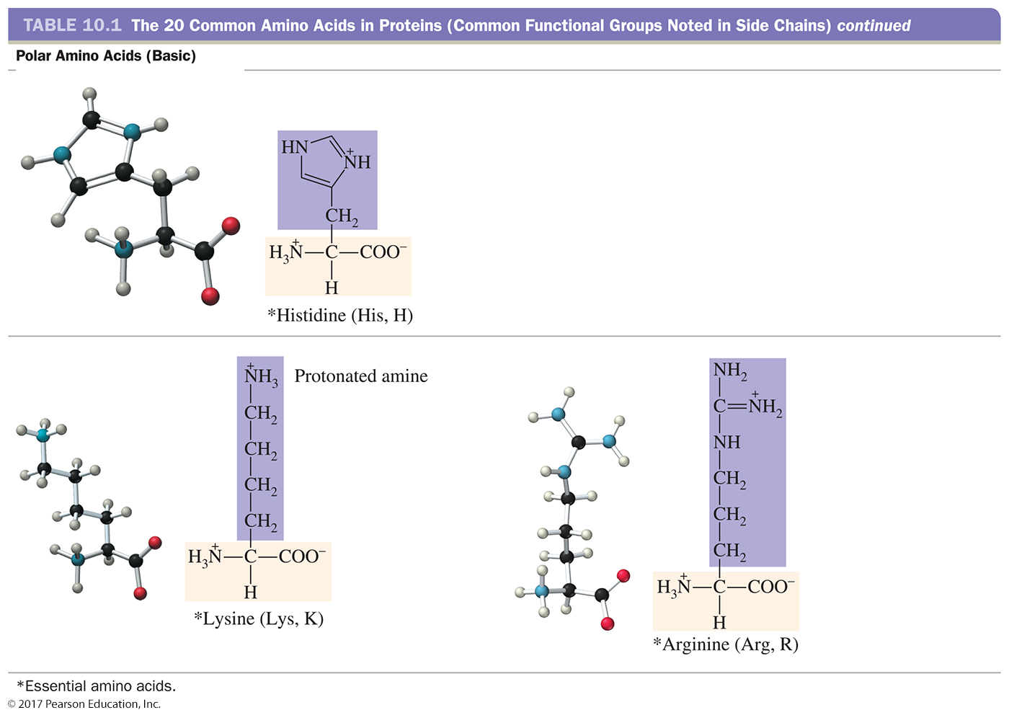
Outline
10.1 Amino Acids—A Second Look
© 2017 Pearson Education, Inc.

Slide 15
Learning Check
An essential amino acid is defined as one that:
How can you tell the difference between nonpolar, polar neutral, polar acidic, and polar basic amino acids?
You don’t need to memorize the structures, names, and abbreviations of the amino acids. BUT you need to be able to tell if they are nonpolar, polar neutral, polar acidic, and polar basic amino acids

Slide 16
Learning Check
Which of the following amino acids is classified as being hydrophobic?
A) Histidine
B) Cysteine
C) Arginine
D) Phenylalanine

Slide 17
Outline
10.2 Protein Formation
Amides and the Peptide Bond
Condensation reactions occur between amino acids, and the product formed is a dipeptide.
The carboxylate ion (—COO–) of one amino acid molecule reacts with the protonated amine (—NH³⁺) of a second amino acid.
A water molecule is removed, and an amide functional group is formed.
Dipeptides can be formed from any two amino acids.
Each pair can combine to form two different dipeptides.
© 2017 Pearson Education, Inc.

Slide 18
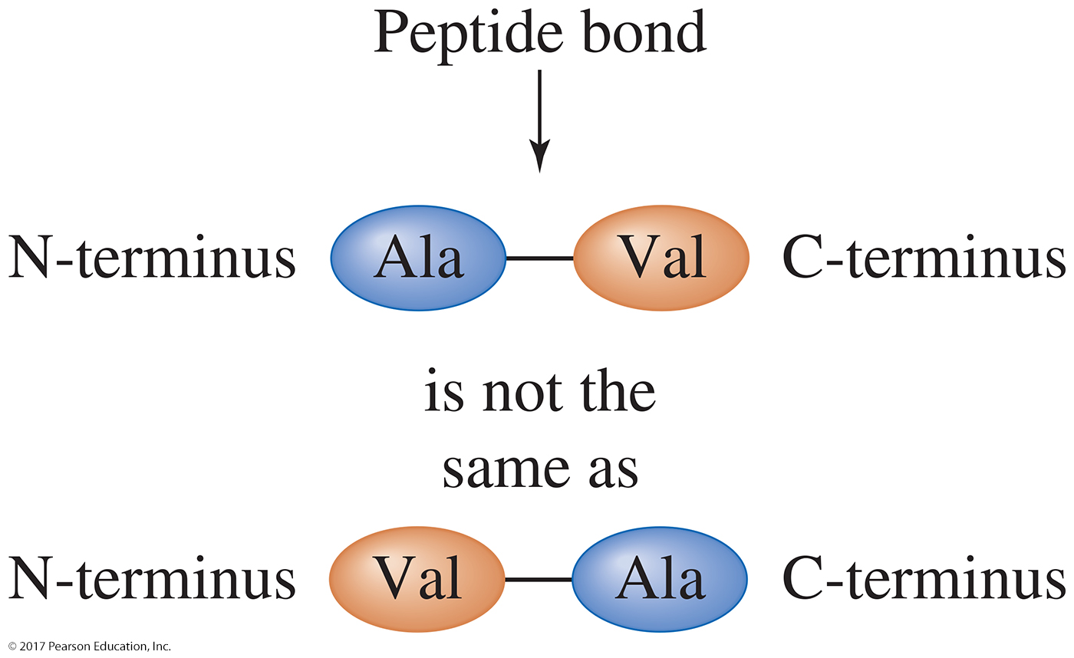
Outline
10.2 Protein Formation
In a dipeptide, the N-terminus (or amino terminus) has an unreacted α-amino group.
The C-terminus (or carboxyl terminus) has an unreacted carboxylate group.
By convention, peptides are always written from the N-terminus to the C-terminus.
The order of the amino acids is critical to the structure and function of the compound.
© 2017 Pearson Education, Inc.

Slide 19
Outline
10.2 Protein Formation
Dipeptides are the smallest members of the peptide class.
Any compound containing amino acids joined by a peptide bond can be called a peptide.
A compound with three amino acids is a tripeptide, one with four amino acids is a tetrapeptide.
As the number of amino acids increases, the compound is referred to as a polypeptide.
A biologically active polypeptide containing 50 or more amino acids is a protein.
© 2017 Pearson Education, Inc.

Slide 20
Which amino acid is the C-terminal group in the following peptide?
Which one is the N-terminal?
What type of peptide is this?
Gly-Ala-Phe-Tyr

Slide 21
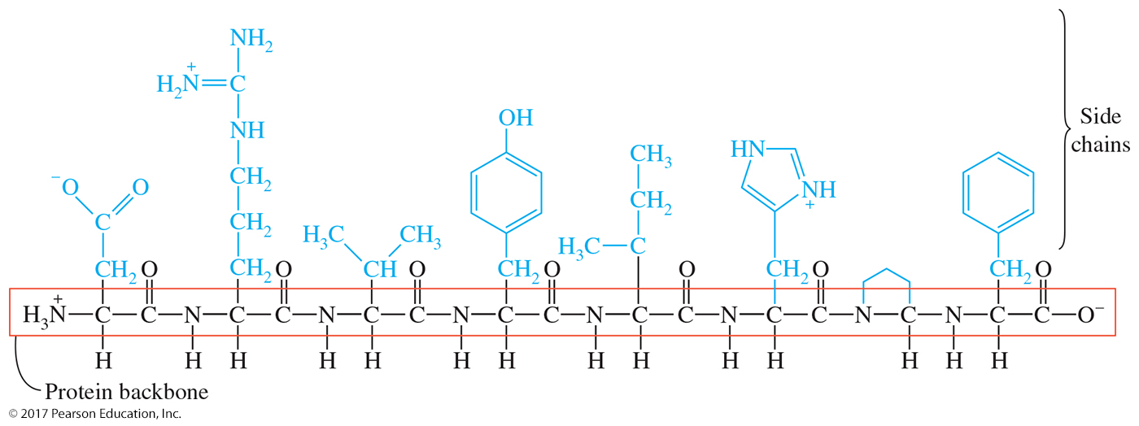
Outline
10.3 The Three-Dimensional Structure of Proteins
Primary Structure
The primary (1°) structure of a protein is the order in which the amino acids are joined together to form the protein backbone.
The side chains of the amino acids are substituents dangling from this backbone.
© 2017 Pearson Education, Inc.

Slide 22
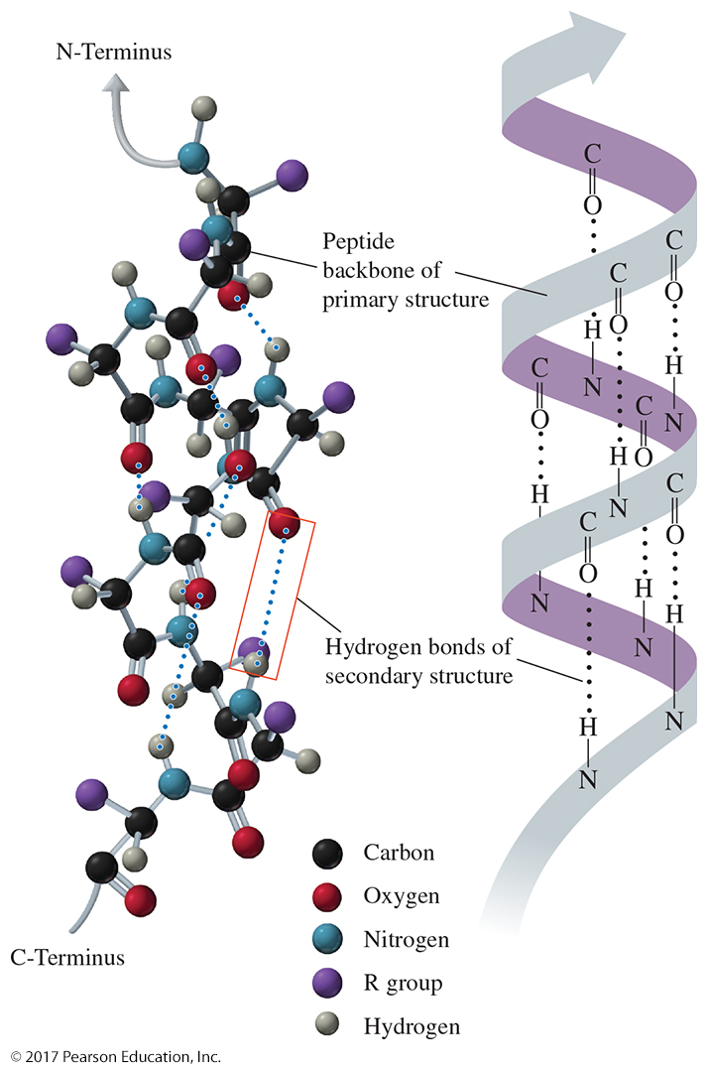
Outline
10.3 The Three-Dimensional Structure of Proteins
Secondary Structure
The α helix is a coiled structure stabilized by hydrogen bonds formed between the carbonyl (C=O) oxygen atom (δ–) of one amino acid and the N—H hydrogen atom (δ⁺) of the amino acid on the fourth amino acid away from it in the primary structure.
The positioning of the hydrogen bonds allows the helix to stretch and recoil. Multiple hydrogen-bonding interactions make the helix a strong structure.
© 2017 Pearson Education, Inc.

Slide 23
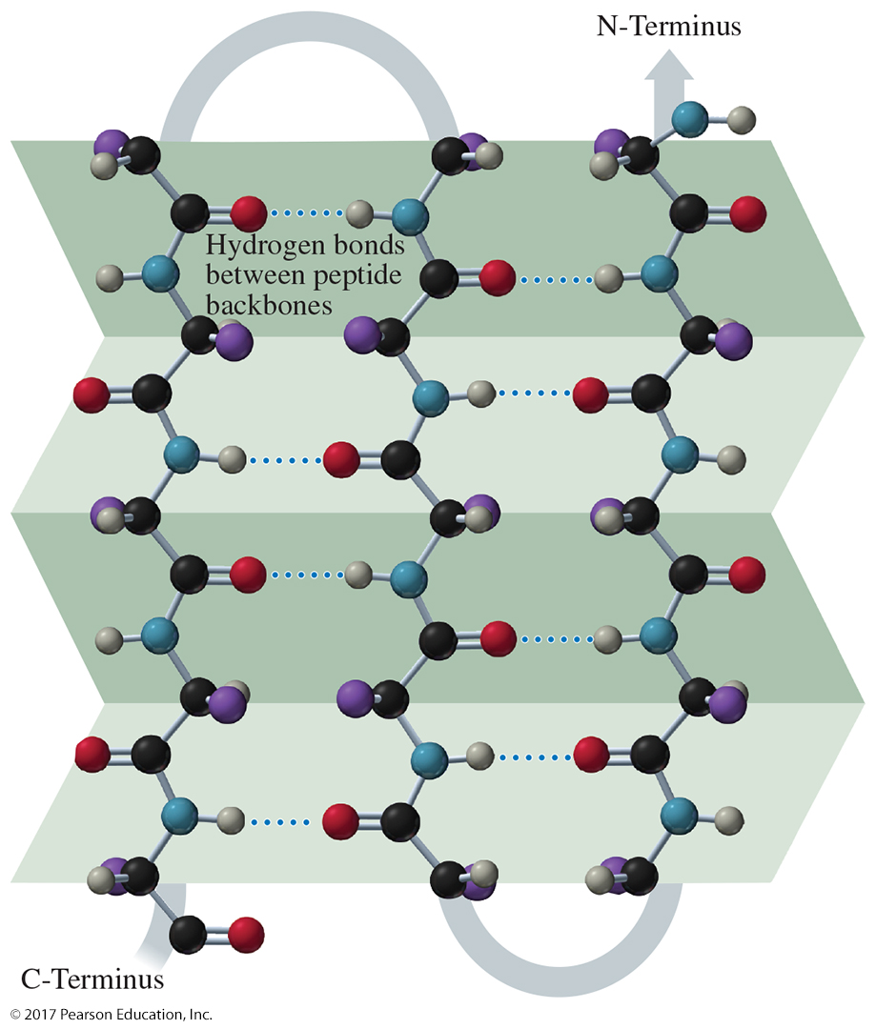
Outline
10.3 The Three-Dimensional Structure of Proteins
Secondary Structure
The β-pleated sheet is an extended structure in which segments of the protein chain align to form a zigzag structure like a folded paper fan.
Beta strands are held together side by side by hydrogen-bonding interactions between their backbones.
© 2017 Pearson Education, Inc.

Slide 24
Outline
10.3 The Three-Dimensional Structure of Proteins
Tertiary Structure
The α helices and β-pleated sheets of the polypeptide chain interact with each other and the environment to create the tertiary (3°) structure.
Tertiary structure is stabilized by attractive forces between side chains and the environment as well as by attractive forces between side chains themselves.
To satisfy all the competing interactions, the protein folds into a specific three-dimensional shape.
© 2017 Pearson Education, Inc.

Slide 25
Outline
10.3 The Three-Dimensional Structure of Proteins
Tertiary Structure Interactions
Nonpolar interactions. Nonpolar amino acid side chains are repelled by the aqueous environment and aggregate in the interior of the protein.
Polar interactions. Polar amino acid side chains interact with water and each other through dipole–dipole, ion–dipole, and hydrogen-bonding interactions.
Salt bridges (ionic interactions). Acidic and basic amino acid side chains exist in their ionized form in an aqueous environment. The opposite charges attract, thereby forming a stabilizing ionic interaction called a salt bridge.
Disulfide bonds. Two —SH groups (thiols) can react with each other through an oxidation reaction (losing hydrogens) to form a disulfide bond (—S—S—). The disulfide bond is a covalent bond.
© 2017 Pearson Education, Inc.

Slide 26
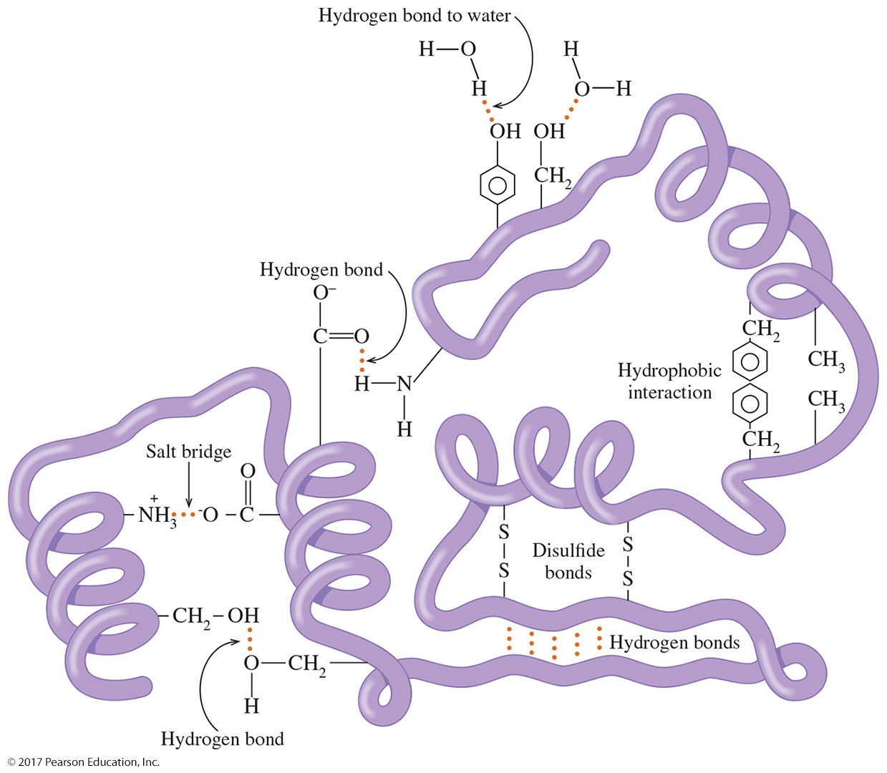
Outline
10.3 The Three-Dimensional Structure of Proteins
© 2017 Pearson Education, Inc.

Slide 27
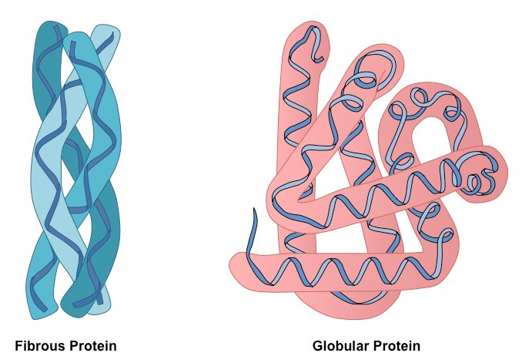
Outline
10.3 The Three-Dimensional Structure of Proteins
Tertiary Structure
Globular proteins fold into a compact, spherical shape with polar amino acid side chains on their surface and nonpolar amino acid side chains forming a nonpolar core. Enzymes and many cellular proteins are globular proteins.
Fibrous proteins have long, threadlike structures. Aligned helices form strong, durable structures. Fibrous proteins tend to be insoluble in water.
© 2017 Pearson Education, Inc.

Slide 28
Outline
10.3 The Three-Dimensional Structure of Proteins
Quaternary Structure
Quaternary (4°) structure describes the interactions of two or more polypeptide chains to form a single biologically active protein.
The individual polypeptide chains or subunits are held together by the same interactions that stabilize the tertiary structure of a single protein.
Not all biologically active proteins have a quaternary structure. Some are made up of a single polypeptide chain.
© 2017 Pearson Education, Inc.

Slide 29
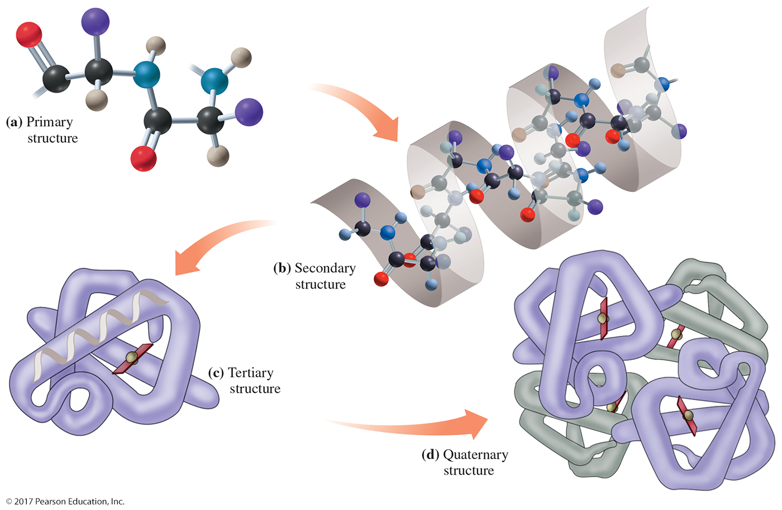
Outline
10.3 The Three-Dimensional Structure of Proteins
© 2017 Pearson Education, Inc.

Slide 30
Learning Check
What are proteins made of?
In your own words, summarize the different protein structures.

Slide 31
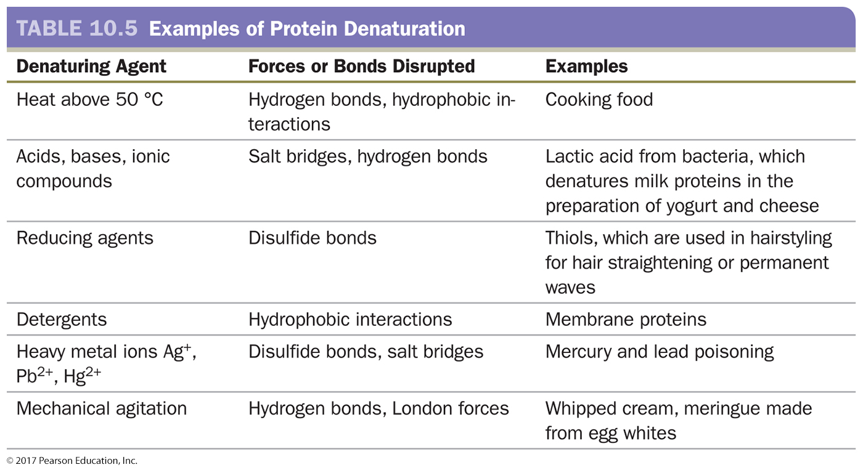
Outline
10.4 Denaturation of Proteins
Denaturation is a process that disrupts the stabilizing attractive forces in the secondary, tertiary, or quaternary structure.
When a protein is denatured, its primary structure is not changed, but it loses its biological activity.
© 2017 Pearson Education, Inc.

Slide 32
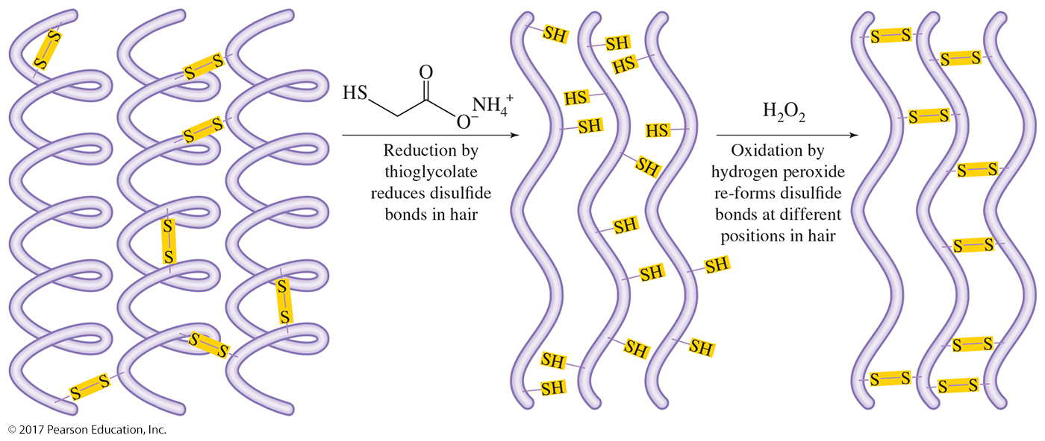
Outline
10.4 Denaturation of Proteins
Hair relaxing and perming involve protein denaturation. Both involve denaturing the proteins in hair by disrupting the disulfide bonds found in the keratin, reshaping the keratin, and forcing the disulfide bonds to re-form.
© 2017 Pearson Education, Inc.

Slide 33
Outline
10.5 Protein Functions
Proteins have many functions in the body.
© 2017 Pearson Education, Inc.

Slide 34
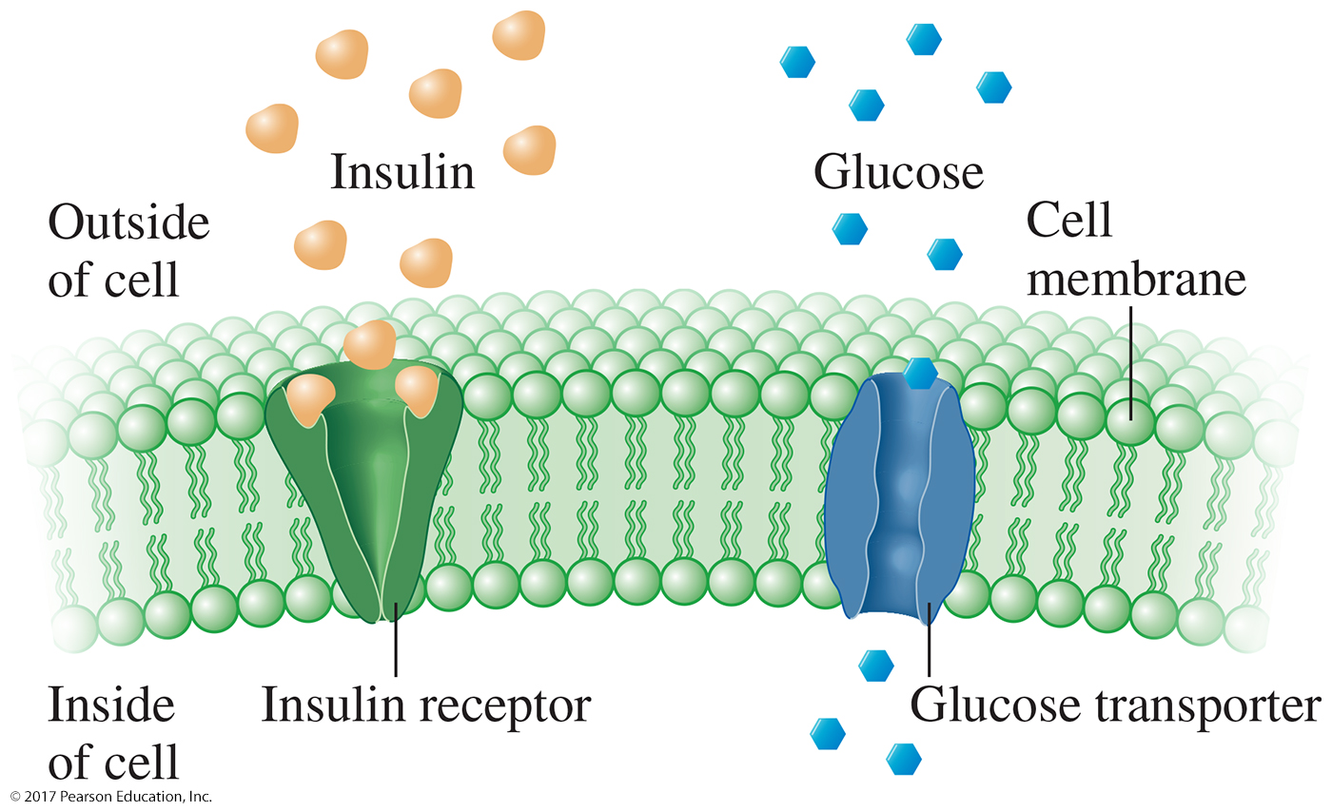
Outline
10.5 Protein Functions
Proteins as Messengers, Receptors, and Transporters
A hormone is a chemical, sometimes a peptide or protein, created in one part of the body that affects another part of the body.(messengers)
Receptors are proteins facing the outer surface of a cell that bind to a hormone or other messenger, triggering a signal inside the cell.
A transporter is an integral membrane protein spanning a phospholipid bilayer.
© 2017 Pearson Education, Inc.

Slide 35
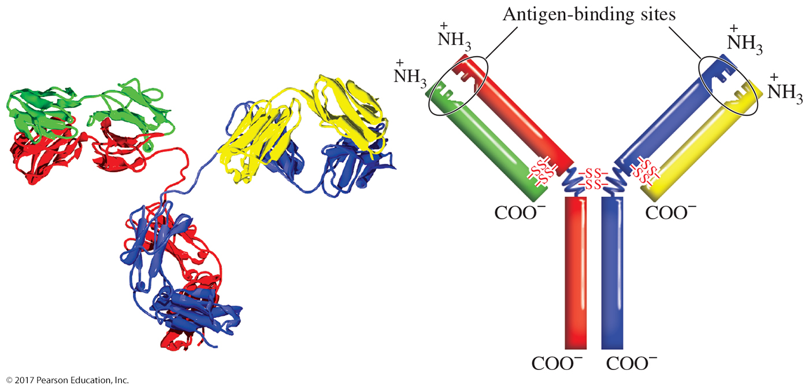
Outline
10.5 Protein Functions
Antibodies—Your Body’s Defense Protein
The substance recognized by an antibody is called an antigen.
The secondary structure contains β-pleated sheets (represented by the flat ribbons) that are stacked tightly together.
The quaternary structure is held together through disulfide bridges between the polypeptide chains.
The stem of the Y is similar in all antibodies and can bind to receptors on a variety of cells in the body. Antibodies bind antigens at the top of each arm of the Y.
© 2017 Pearson Education, Inc.

Slide 36
Outline
10.6 Enzymes—Life’s Catalysts
Enzymes are typically large globular proteins and are present in every cell of the body.
Enzymes act as catalysts, compounds that accelerate the reactions of metabolism but are not consumed or changed by those reactions.
An enzyme cannot force a reaction to occur that would not normally occur. An enzyme simply makes a reaction occur faster.
The tertiary structure of an enzyme plays an important role in its function.
© 2017 Pearson Education, Inc.

Slide 37
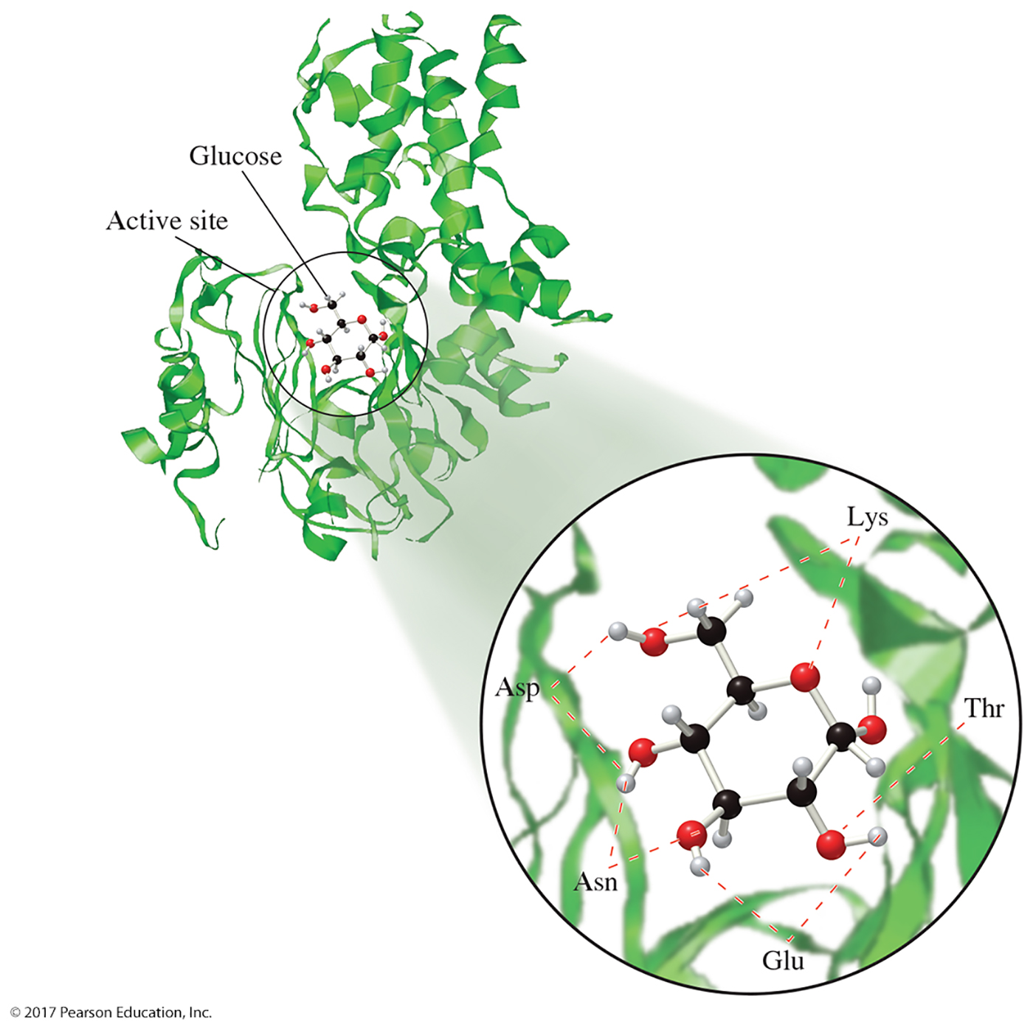
Outline
10.6 Enzymes—Life’s Catalysts
The enzyme name usually appears above or below the reaction arrow.
The active site is the part of the enzyme where catalysis occurs.
The reactant is the substrate.
The active site of hexokinase fits D-glucose only due to substrate specificity.
© 2017 Pearson Education, Inc.

Slide 38
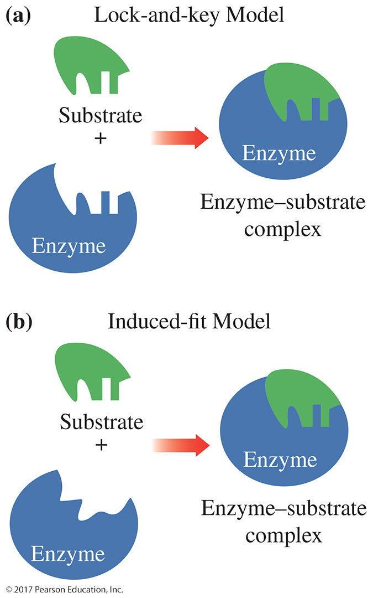
Outline
10.6 Enzymes—Life’s Catalysts
Enzyme–Substrate Models
The initial interaction is the enzyme–substrate complex (ES).
Several models describe how the ES is formed.
Lock-and-key model. The active site is a rigid, inflexible shape that is an exact complement to the substrate.
Induced-fit model. The enzyme’s active site is flexible and roughly complementary to the substrate.
© 2017 Pearson Education, Inc.

Slide 39
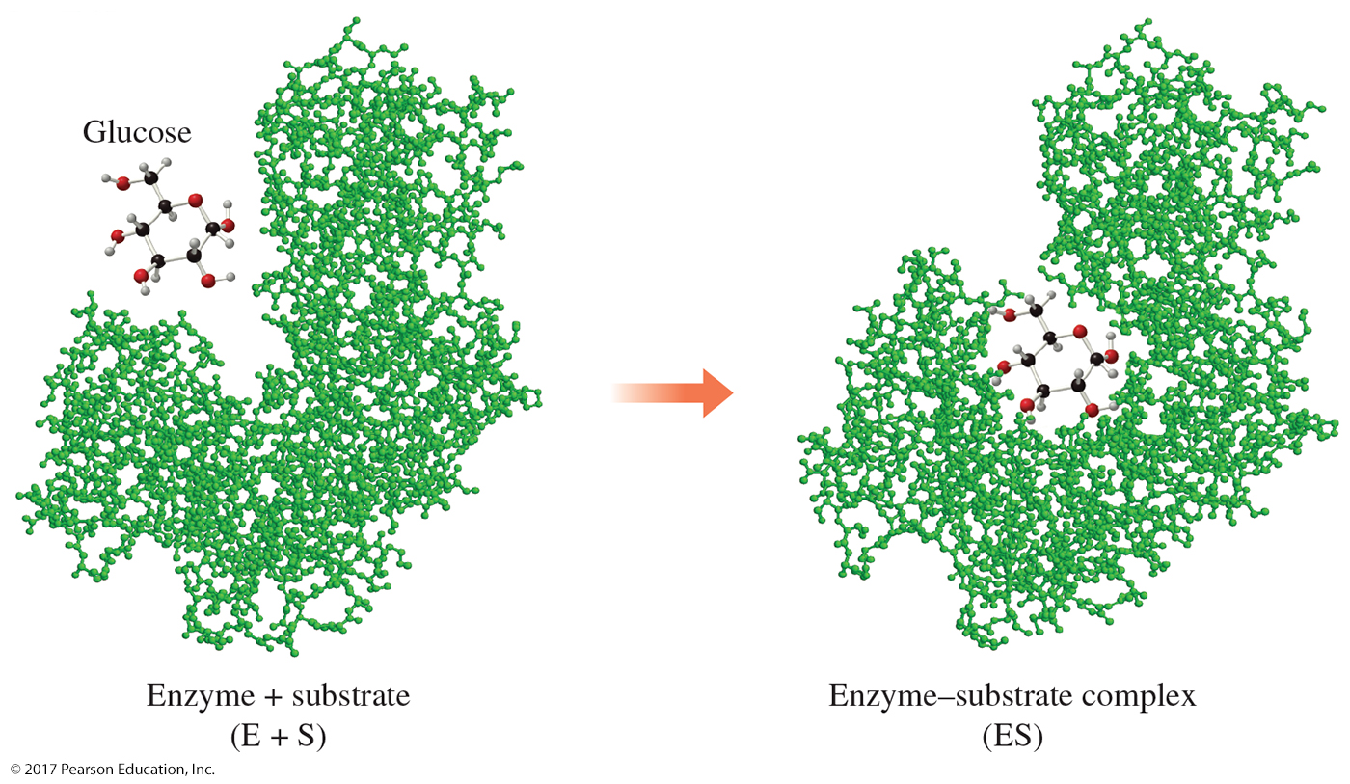
Outline
10.6 Enzymes—Life’s Catalysts
© 2017 Pearson Education, Inc.

Slide 40
Learning Check
What does ES mean?
Summarize how the two types of ES Models work.

Slide 41
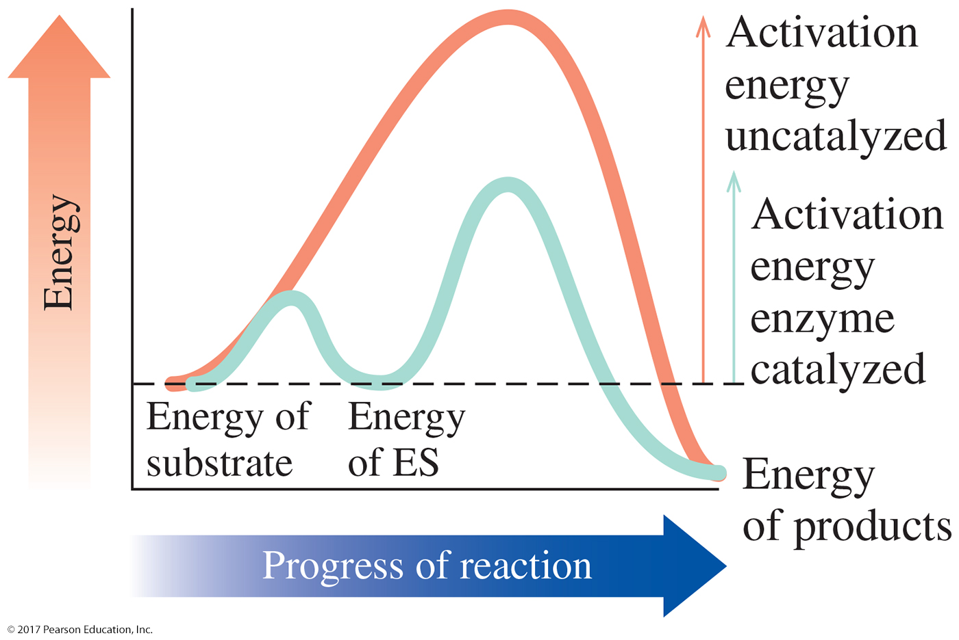
Outline
10.6 Enzymes—Life’s Catalysts
Rates of Reaction
Activation energy lowering is accomplished during the formation of ES by proximity, orientation, and bond energy.
Proximity. When the ES forms, the substrates are in close proximity. They don’t have to find each other as they would in solution. (Held in place)
© 2017 Pearson Education, Inc.

Slide 42
Outline
10.6 Enzymes—Life’s Catalysts
Rates of Reaction
Orientation. when an enzyme interacts with its substrate to form ES, the bonds of the substrate molecule(s) are weakened (strained).
Bond energy. The weakening of the bonds means that they will more readily react: Weaker bonds break more easily and the activation energy is lowered by this effect.
© 2017 Pearson Education, Inc.

Slide 43
Learning Check
Summarize how the formation of an ES lowers the activation energy of the substrate(reactant)?

Slide 44
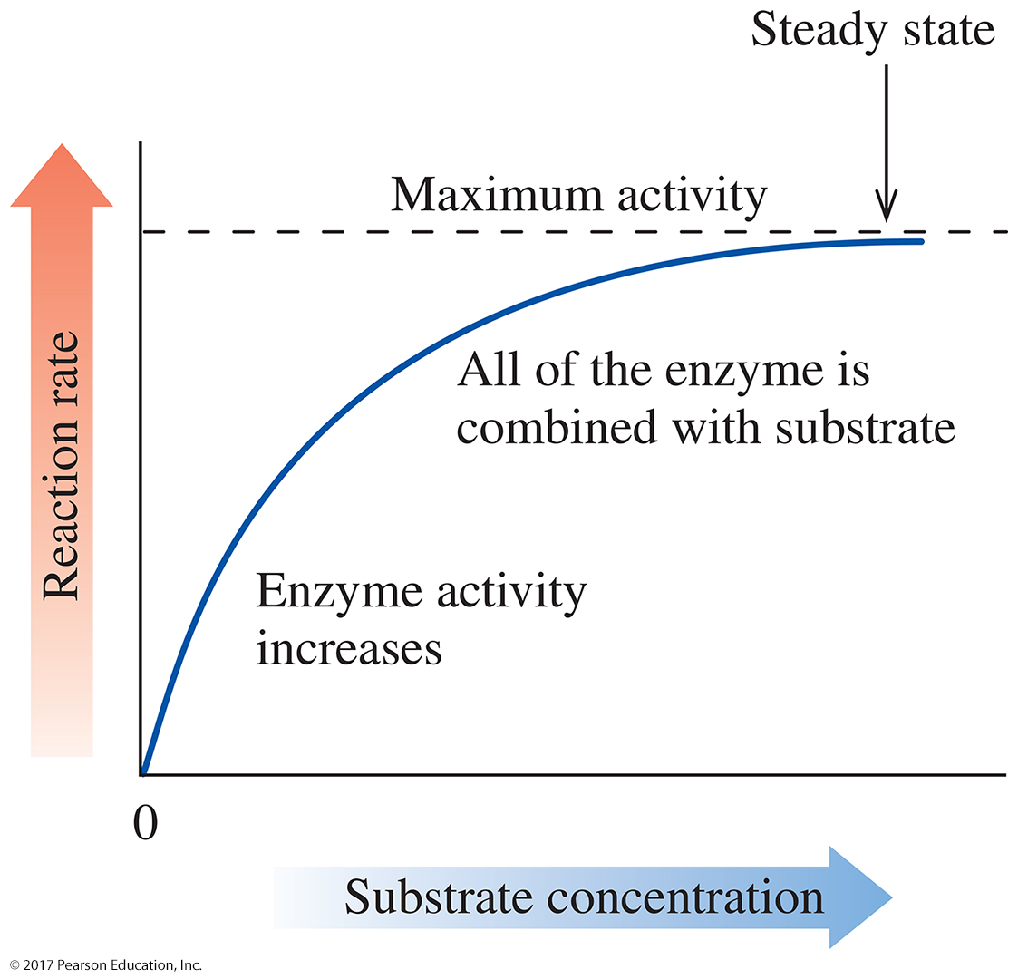
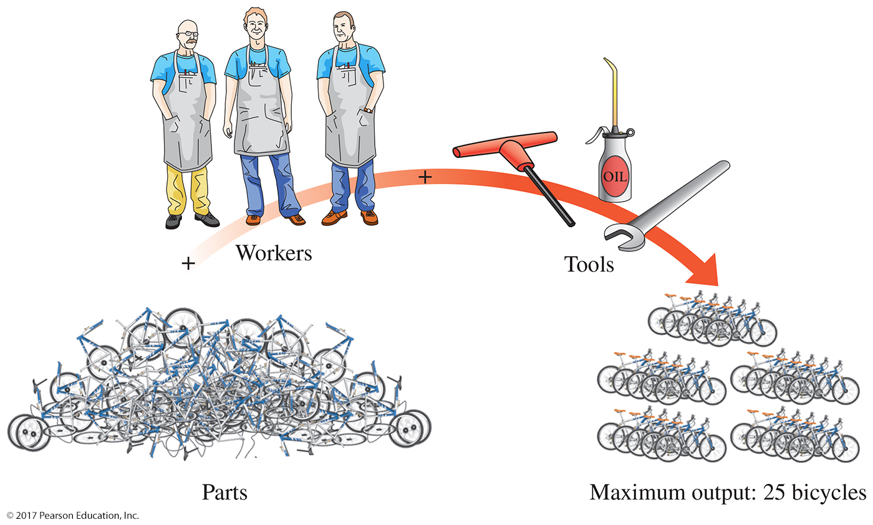
Outline
10.7 Factors That Affect Enzyme Activity
Substrate Concentration
The first step in an enzyme-catalyzed reaction is the formation of ES.
If the amount of enzyme remains unchanged, an increase in substrate concentration increases the enzyme’s activity to the point at which the enzyme is saturated with its substrate.
At maximum activity, the conditions under which the enzyme is operating are considered to be in a steady state.
© 2017 Pearson Education, Inc.

Slide 45
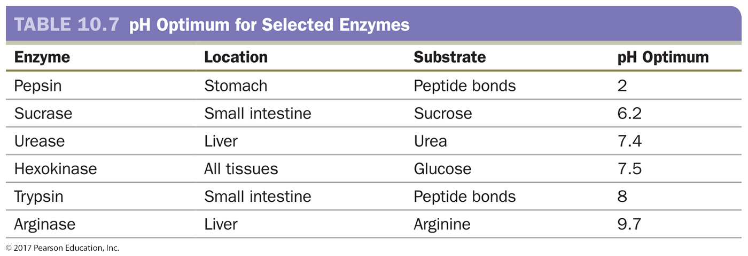
Outline
10.7 Factors That Affect Enzyme Activity
pH
Enzymes are most active at their pH optimum. At this pH, the enzyme maintains its tertiary structure and, therefore, its active site.
Changes in the pH may change the nature of an amino acid side chain.
© 2017 Pearson Education, Inc.

Slide 46
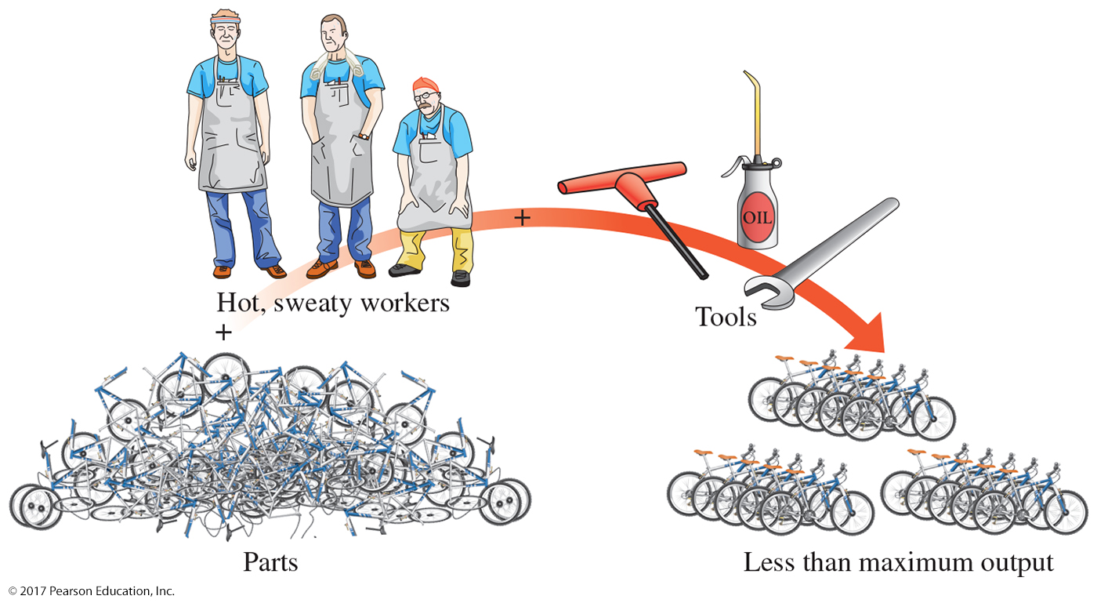
Outline
10.7 Factors That Affect Enzyme Activity
Temperature
The temperature optimum for most human enzymes is normal body temperature, 37 °C.
Above their optimum temperature, enzymes lose activity due to the disruption of the attractive forces stabilizing the tertiary structure.
At high temperatures, an enzyme denatures.
At low temperatures, enzyme activity is reduced due to the lack of energy present for the reaction to take place at all.
© 2017 Pearson Education, Inc.

Slide 47
Outline
10.7 Factors That Affect Enzyme Activity
Inhibitors
Enzyme inhibitors prevent the active site from interacting with the substrate to form ES.
Some inhibitors cause enzymes to lose catalytic activity temporarily, while others cause enzymes to lose activity permanently.
In reversible inhibition, the inhibitor causes the enzyme to lose catalytic activity. If the inhibitor is removed, the enzyme becomes functional.
Reversible inhibitors can be competitive or noncompetitive.
© 2017 Pearson Education, Inc.

Slide 48
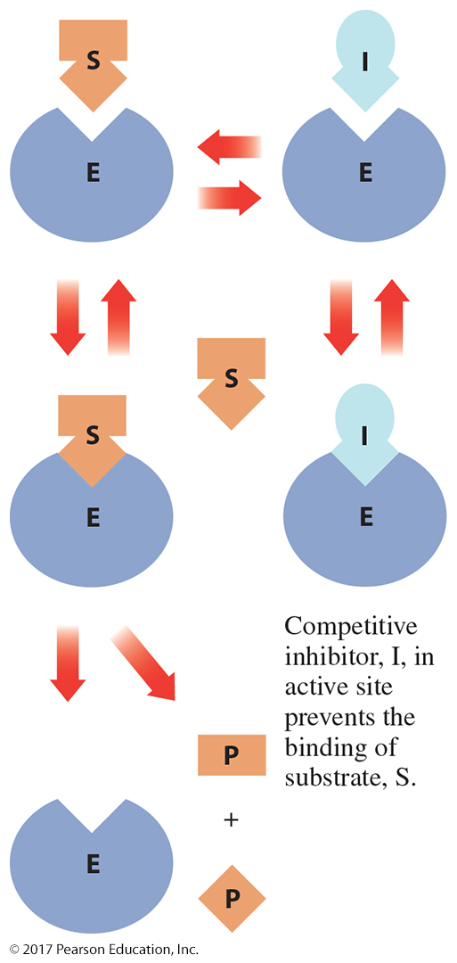
Outline
10.7 Factors That Affect Enzyme Activity
Inhibitors
A competitive inhibitor has a structure that resembles the substrate.
The competitive inhibitor will form an enzyme–inhibitor complex, but no reaction will take place.
As long as the inhibitor remains in the active site, the enzyme cannot interact with its substrate and form product.
Inhibition caused by a competitive inhibitor can be reversed by adding more substrate.
© 2017 Pearson Education, Inc.

Slide 49
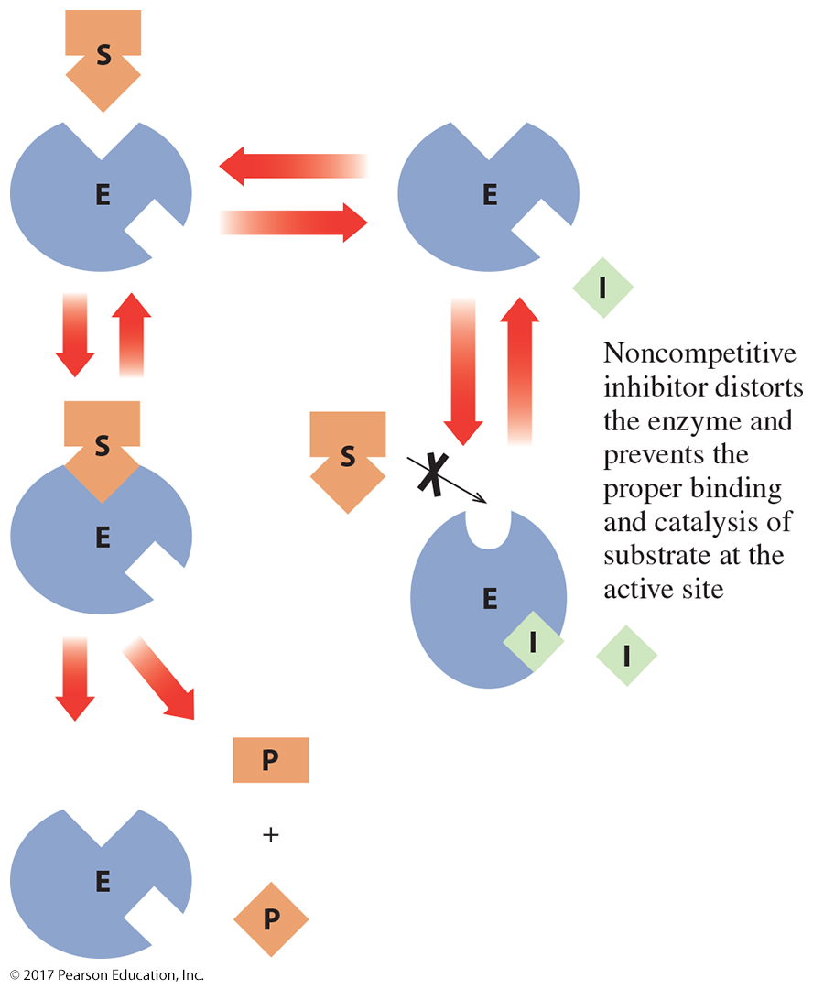
Outline
10.7 Factors That Affect Enzyme Activity
Inhibitors
Noncompetitive inhibitors bind to another site on the enzyme, changing its shape.
In the case of a noncompetitive inhibitor, adding more substrate has no effect.
Regardless of the amount of enzyme, a certain portion of the enzyme is inactivated by the inhibitor.
Reversing the effect of a noncompetitive inhibitor requires a special chemical agent.
© 2017 Pearson Education, Inc.

Slide 50
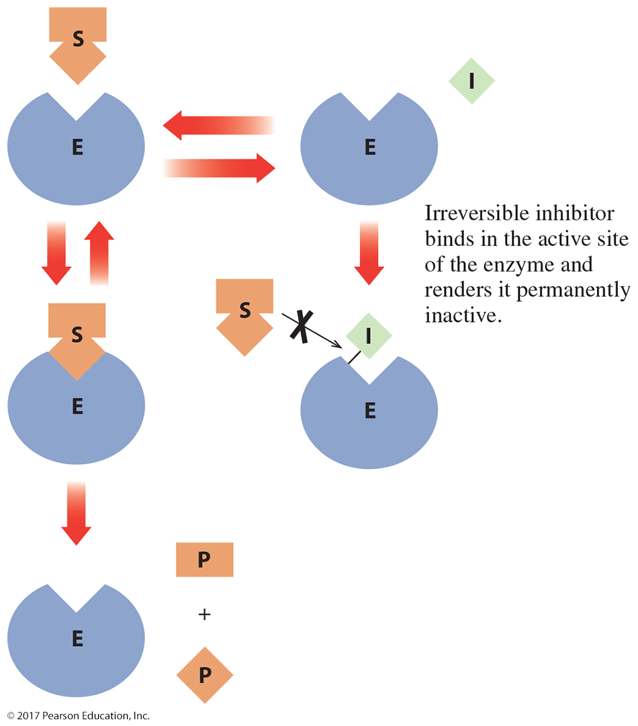
Outline
10.7 Factors That Affect Enzyme Activity
Inhibitors
In irreversible inhibition, the inhibitor forms a covalent bond with an amino acid side chain in the active site.
The substrate is excluded or the catalytic reaction blocked.
Irreversible inhibitors permanently inactivate enzymes.
© 2017 Pearson Education, Inc.

Slide 51
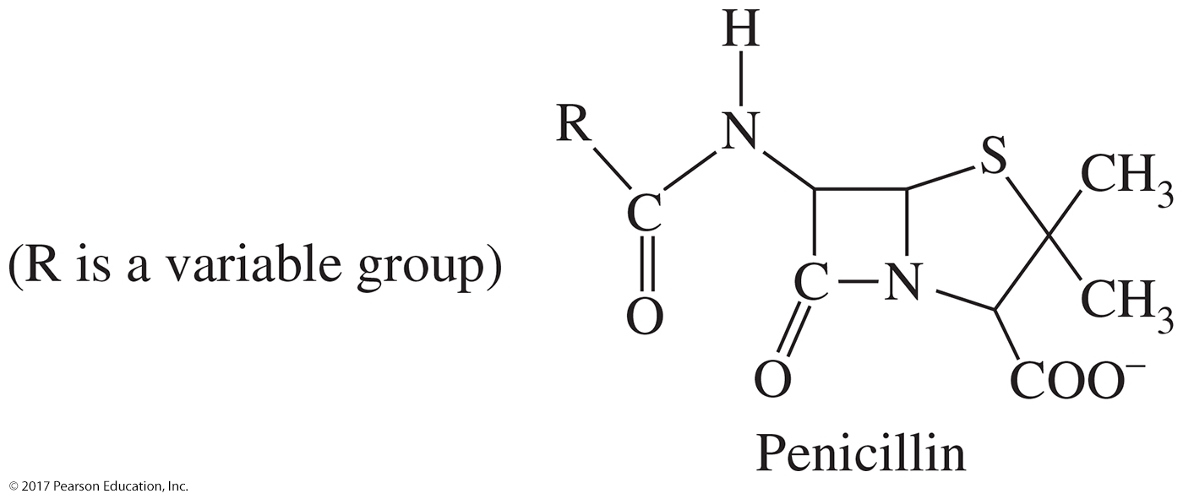
Outline
10.7 Factors That Affect Enzyme Activity
Antibiotics Inhibit Bacterial Enzymes
Penicillin is an irreversible inhibitor.
Penicillin binds to the active site of an enzyme that bacteria use in the synthesis of their cell walls.
When the bacterial enzyme bonds with penicillin, the enzyme loses its catalytic activity, and the growth of the bacterial cell wall slows.
© 2017 Pearson Education, Inc.

Slide 52
Learning Check
List the three main factors that affect Enzyme activity.

Slide 53
Learning Check
Fill the in blanks/ finish the statement.
The point at which an enzyme reacts at its maximum activity is called a ___________.
An irreversible inhibitor is one that _____.
The 2 types of reversible inhibitors are _________ and ___________.

Slide 55
Outline
Chapter 10 Study Guide
10.1 Amino Acids—A Second Look
Characterize the structure of an amino acid.
Draw the general structure of an amino acid.
Identify amino acids based on their polarity.
10.2 Protein Formation
Form peptide bonds from amino acids.
Predict the products of a biological condensation or hydrolysis reaction, including peptide bond formation.
Draw a short peptide sequence given its one-letter or three-letter abbreviations.
Identify the N-terminus and C-terminus of a short peptide sequence.
© 2017 Pearson Education, Inc.

Slide 56
Outline
Chapter 10 Study Guide (continued)
10.3 The Three-Dimensional Structure of Proteins
Describe how the levels of protein structure maintain protein shape.
Describe the attractive forces present as a protein folds into its three-dimensional shape.
Distinguish the levels of protein structure.
10.4 Denaturation of Proteins
Define protein denaturation and discuss its causes.
List the causes of protein denaturation and the attractive forces affected.
10.5 Protein Functions
Compare the various functions of proteins.
Identify various functions of proteins.
Provide examples of protein structure dictating protein function.
© 2017 Pearson Education, Inc.

Slide 57
Outline
Chapter 10 Study Guide (continued)
10.6 Enzymes—Life’s Catalysts
Describe how an enzyme catalyzes a biochemical reaction.
Define active site and substrate.
Distinguish the lock-and-key model from the induced-fit model.
Discuss factors that lower the activation energy and speed reaction for an enzyme-catalyzed reaction.
10.7 Factors That Affect Enzyme Activity
Discuss factors that enhance and inhibit enzyme activity.
Describe how substrate concentration, pH, temperature, and inhibition affect enzyme activity.
Distinguish competitive, noncompetitive, and irreversible inhibition.
© 2017 Pearson Education, Inc.

Slide 58
Additional Practice Problems and Videos
Book –
YouTube-
Biomolecule Summary- Chapters 6, 7, and 10. https://www.youtube.com/watch?v=H8WJ2KENlK0
Amino Acids, Peptide Bonds, Protein Structure-
https://www.youtube.com/watch?v=hok2hyED9go
Enzymes and Denaturation-
https://www.youtube.com/watch?v=qgVFkRn8f10
Chapter | Page | Questions | Answers on
10 | 422 | 51, 63, 69, 77, 79, 89, 93 | 427

